Slide 1
Chapter 5
Paired Samples T Test

Slide 2
Learning Objectives
Teach statistical thinking
Students will be able to state the null and alternative hypotheses for paired samples t tests
Students will understand the appropriate use of paired samples t tests
Students will know how to accurately write the results of paired samples t tests in APA format
Focus on conceptual understanding
Students will understand the distinction between repeated measures and matched pairs designs
Students will know how to interpret the results of paired samples t tests
Students will be able to translate the results of a paired samples t test into real world meaning (i.e., how would you explain the results to someone not taking this course?)
Use technology to explore concepts and analyze data
Students will know how to test that the dataset meets the assumptions needed to run paired samples t tests
Students will know how to run paired samples t tests in JASP

Slide 3
Background (kusumastuti et al., 2017)
Research question: If ageism can impact the way people provide healthcare, are there ways to reduce ageism among healthcare providers? In the medical field, they have tried to fight ageism by incorporating care internships for medical students that involve working with older populations, but does this approach work?
Design: Students were assigned to older adults in need of intensive care for a two-week internship, and researchers measured their attitudes toward old people before and after the internship
Participants: 315 first-year medical students
Measures: Attitudes Toward Old People scale
Results: A paired samples t test revealed that working closely with older adults resulted in worse attitudes toward older adults after the two-week internship
Before: M = 118.4, SD = 17.4
After: M = 112.1, SD = 19.4

Slide 4
Let’s think about it…
Why did the researchers use Paired-samples t tests to answer their research questions?
What do their results mean?
How would you improve this study?
Notes:
1. The researchers were comparing two paired means (before and after) on a continuous dependent variable.
2. Medical students actually held more negative attitudes toward older people after their internship. The authors point out that the increased levels of negative attitudes toward older adults after the internship could be explained by the lack of experience students and training students had with older adults prior to their internship. Another potential explanation is that students were specifically working with a population of older adults that–in many cases–fit and confirmed the negative stereotypes that medical students had about older adults. Overall, these results suggest that contact with members of groups who are targets of negative stereotypes—like older individuals—does not always reduce prejudice towards those individuals, and in some cases, may even increase prejudice.
3. There were a couple of limitations of this study worth highlighting. One limitation is that there was no comparison condition. How would the results compare to a group of medical students working with a different population? Second, the internship only lasted two weeks, which is a relatively short amount of time for interacting with older adults. Future research might look at a longer timeframe to compare attitudes across.

Slide 5
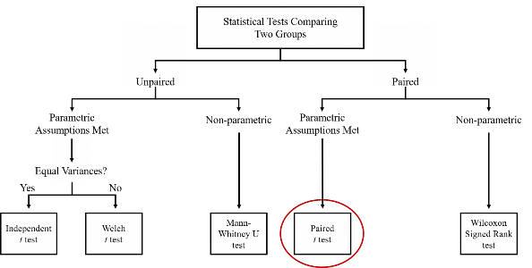
Introduction to Paired Samples T Tests
As with an independent measures t test, a paired samples t test explores differences between the means of two groups of scores
The main difference between an independent measures t test and a paired samples t test involves the nature of how those scores are grouped together
With an independent measures t test, the two groups of scores are not related to one another (hence, the term “independent”)
With a paired samples t test, the two groups of scores are related to one another in some way

Slide 6
How are groups of scores related
Typically, in psychology, scores are paired using either a repeated measures design or a matched pairs design
With a repeated measures design, observations involve participants who are the same individual tested at two points in time, or under two unique conditions or treatments, on an outcome variable; in this research design, each participant provides two scores on the same dependent measure
With a matched pairs design, groups of scores do involve two separate groups of participants, but they are related to one another because the researcher purposefully matches participants on one or more characteristic; both groups of matched participants are then tested on the dependent variable

Slide 7
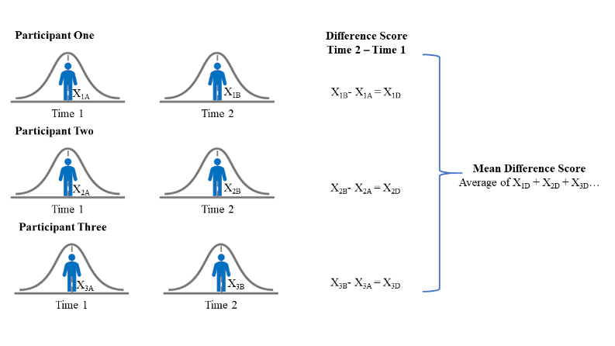
What is a paired samples t test?
In a paired samples t test, groups of scores are compared by calculating a difference score for the mean of each group
In a paired samples t test, a difference score is compared to a value of zero to see if it is different enough from zero to suggest statistical and/or practical significance

Slide 8
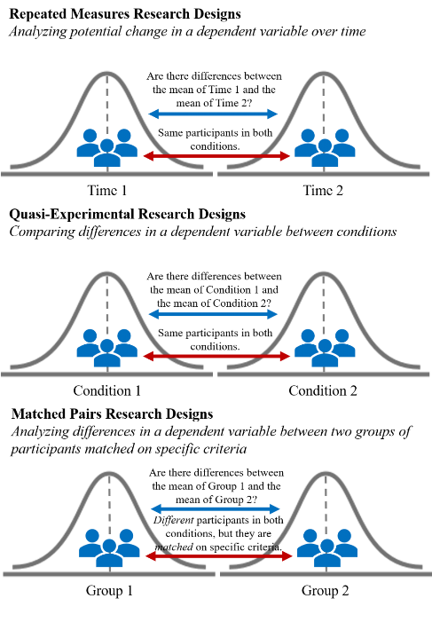
When do researchers use paired samples t tests?
Repeated measures design: Is there a change in the dependent variable over two points in time?
Are the scores on the dependent variable different between Time 1 and Time 2? Is the mean score higher or lower at Time 2?
Quasi-Experimental design: Is there a change in the dependent variable between two treatment conditions?
Are the scores on the dependent variable different between treatment condition 1 and treatment condition 2? For which treatment condition is the mean score higher/lower?
Matched pairs design: Participants are either in one group or the other, but scores for each “pair” of participants are matched on some criteria
Are the scores on the dependent variable different between group 1 and group 2? For which group is the mean score higher/lower?

Slide 9
hypotheses
Null hypothesis:
Conceptual H0: There is no significant difference in DEPENDENT VARIABLE between Time 1/Condition 1 and Time 2/Condition 2; there is no significant difference in DEPENDENT VARIABLE before and after EVENT
Mathematical H0: The population mean difference between the paired observations is equal to zero; MD = 0
Alternative hypothesis:
Conceptual H1: There is a significant difference in DEPENDENT VARIABLE between Time 1/Condition 1 and Time 2/Condition 2; there is a significant difference in DEPENDENT VARIABLE before and after EVENT
Mathematical H1: The population mean difference between the paired observations is significantly different from zero; MD ≠ 0

Slide 10
assumptions
There is one dependent variable that is continuous
There is one independent variable that consists of two categorical related groups
There are no significant outliers in the difference scores
The difference scores are approximately normally distributed

Slide 11
Assumption 1
There is one dependent variable that is measured at the continuous (i.e., ratio or interval) level
To run a paired samples t test, our dependent variable must be continuous, meaning it must be measured on an interval or ratio scale of measurement
Because a paired samples t test compares the means between groups of scores on the dependent variable, the dependent variable must be continuous to calculate these values
In psychological research, dependent variables are commonly measured using Likert-type scales which are typically viewed as measured on an interval scale, or using ratio scales of measurement (e.g., “How many cigarettes have you smoked in the past week?”)

Slide 12
Assumption 2
There is one independent variable that consists of two categorical related groups
In a paired samples t test, we must have related groups of scores (the two groups are not independent
Typically, this means that there will be the same participants in each group
Each participant provides a score on the dependent variable at two different time points or under two different conditions

Slide 13
Assumption 3
There are no significant outliers in the difference scores between the two related groups
For a paired samples t test, there should be no significant outliers in the difference scores for our related groups
If there are significant outliers, this could impact the mean of the difference scores by exaggerating the difference scores
We will determine whether we have outliers by examining boxplots

Slide 14
Assumption 4
The distribution of the differences scores between the two related groups should be approximately normally distributed
A paired samples t test is a parametric test, which necessitates the assumption of normality
This assumption is considered “robust” to violation: minimal violations of normality can still provide valid results
Based on the Central Limit Theorem, if our sample size is large enough, then the paired samples t test can handle non-normal distributions
With a paired samples t test, we will be testing whether the difference scores between the two paired observations are normally distributed by examining skewness and kurtosis statistics (and the Shapiro-Wilk test, depending on sample size)

Slide 15
Statistical significance
Whether or not a statistical test is statistically significant depends on the p-value, which is set by alpha (Type I Error)
In psychological research, we tend to use an alpha level of 0.05 (and therefore, a p-value of 0.05) as the traditional cutoff for statistical significance
With an alpha and p-value of 0.05, if we were to collect data and run a paired samples t test 100 times, five out of 100 times, we will reject the null hypothesis (indicating a significant difference in the paired groups of scores), and the other 95 times we would fail to reject the null hypothesis (indicating no significant difference in the paired groups of scores)

Slide 16
Practical significance
Researchers often consider effect sizes as a measure of the strength of an observed difference or relationship
As with an independent measures t test, we observe the effect size for a paired samples t test using Cohen’s d
In a paired samples t test, the mean of the difference scores is divided by the standard deviation of the difference scores

Slide 17
JASP Walk-Through Example
The Association of American Universities conducted a Campus Climate Survey on Sexual Assault and Misconduct in 2019. After surveying over 181,000 students across 33 colleges and universities, they found that 13% reported experiencing non-consensual sexual contact. With women and transgender students reporting significantly higher rates than men. One way that colleges and universities have been working to reduce rates of sexual assault is through educational programs that teach students how to intervene to prevent sexual assault. Researchers Banyard, Moynihan, and Plante (2007) created a bystander intervention program to prevent sexual assault on college campuses. In their research article, they present data demonstrating the efficacy of effectiveness of their intervention program.
To study the efficacy of the program, participants were separated into three different groups: a control group that did not attend a prevention program, a group that attended a one-session prevention program, and a group that attended a three-session prevention program.
Bystander self-efficacy was measured in this study using a 14-item measure of participant confidence to perform bystander behavior. Participants were asked to rate how confident they are that they can perform 14 different types of bystander behavior from 0 (“can’t do”) to 100 (“very certain can do”).

Slide 18
Research Question
Does the bystander intervention program make people more confident in their ability to perform bystander behavior?

Slide 19
What do you think we will find when we analyze the data?
What are your hypotheses?

Slide 20
Hypotheses
The null hypothesis is:
Conceptual H₀: There is no significant difference in bystander self-efficacy scores for the One-Session Prevention Group before and after the bystander intervention program.
The alternative hypothesis is:
Conceptual H₁: There is significant difference in bystander self-efficacy scores for the One-Session Prevention Group before and after the bystander intervention program.
Mathematical H₀: The population mean difference on bystander self-efficacy scores before and after the bystander intervention program is equal to zero; M_{D} = 0.
Mathematical H₁: The population mean difference on bystander self-efficacy scores before and after the bystander intervention program is not equal to zero; M_{D} ≠ 0.

Slide 21
Let’s Analyze the Data!
Notes:
This Photo by Unknown Author is licensed under CC BY-ND

Slide 22
Notes:
CC BY-NC-ND: This license allows reusers to copy and distribute the material in any medium or format in unadapted form only, for noncommercial purposes only, and only so long as attribution is given to the creator.

