Slide 1
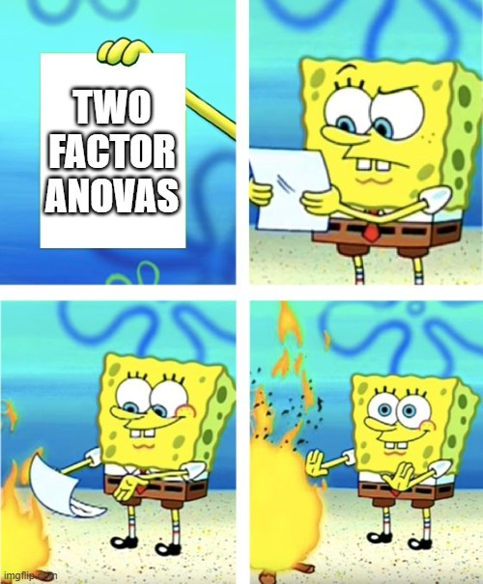
Chapter ?
Two Way ANOVA

Slide 2
Learning Objectives
Teach statistical thinking
Students will be able to state the null and alternative hypotheses for a two-way ANOVA.
Students will understand the appropriate use of a two-way ANOVA.
Students will know how to accurately write the results of a two-way ANOVA in APA format.
Focus on conceptual understanding
Students will know how to interpret the results of a two-way ANOVA.
Students will be able to translate the results of a two-way ANOVA into real world meaning (i.e., how would you explain the results to someone not taking this course?).
Use technology to explore concepts and analyze data
Students will know how to test that the dataset meets the assumptions needed to run a two-way ANOVA.
Students will know how to run a two-way ANOVA in JASP.

Slide 3
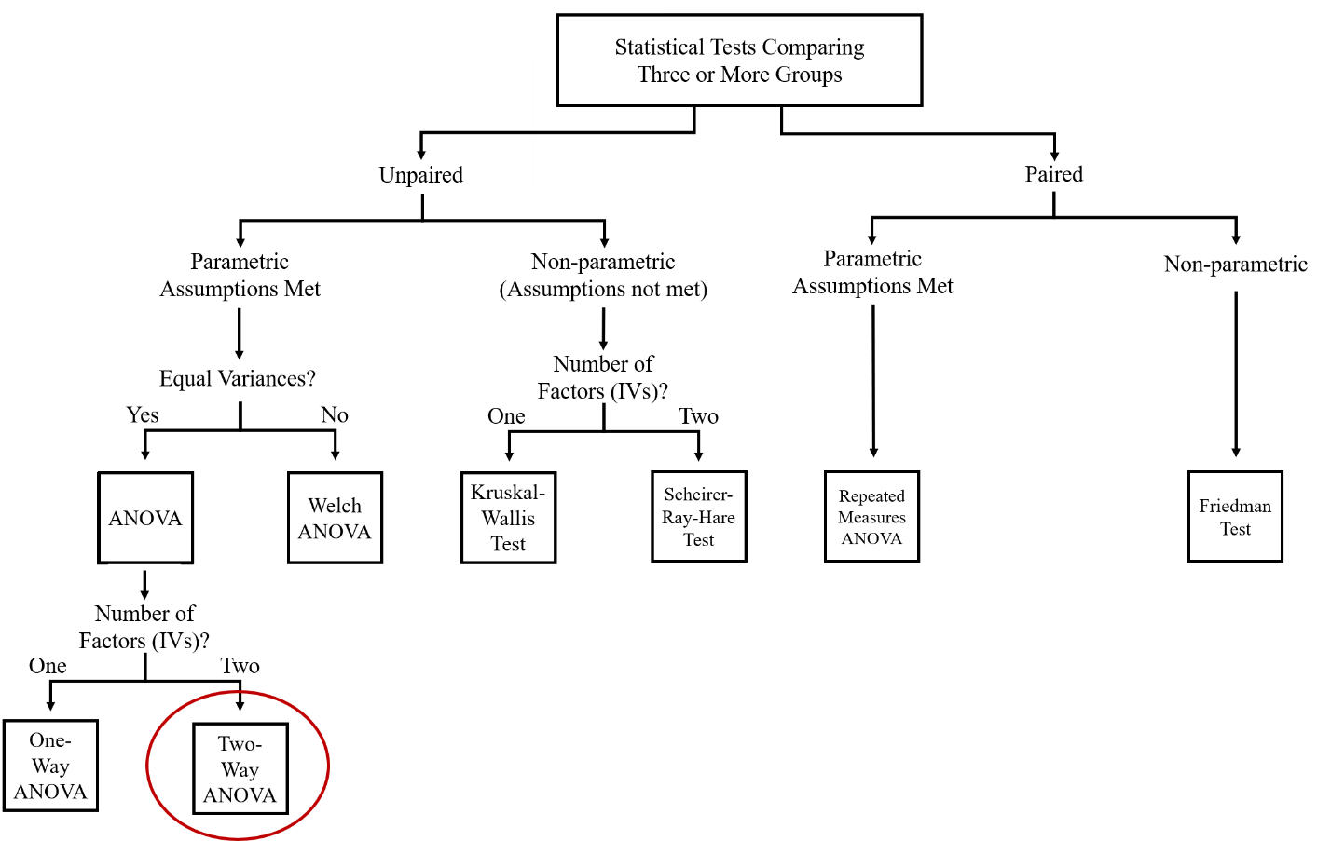
What is a two-way ANOVA?
A statistical test that determines if the impact of one independent variable on the outcome variable varies depending on the level of the second independent variable

Slide 4
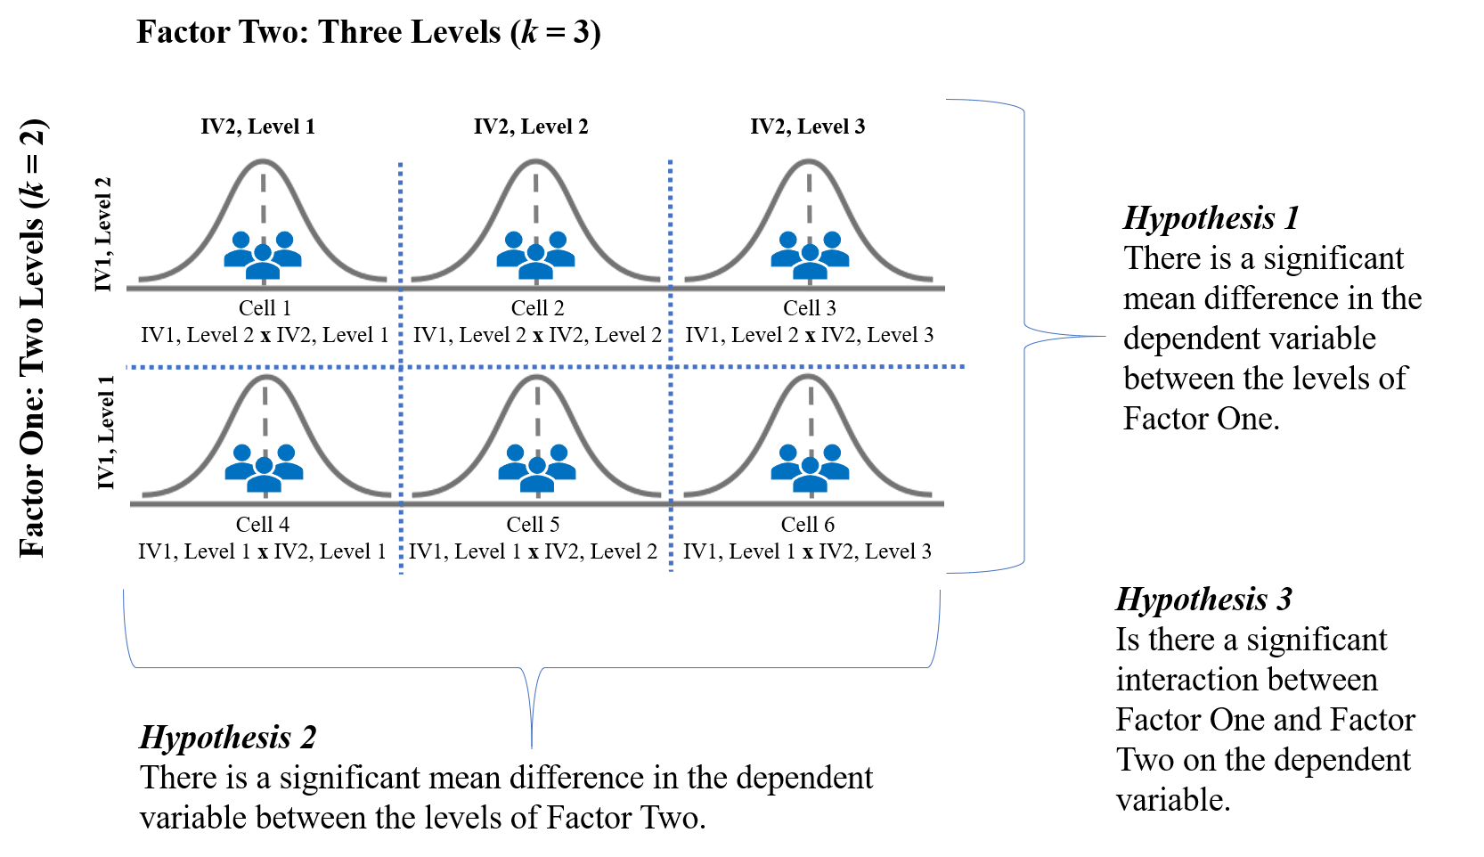
When do researchers use two-way ANOVAs?
To determine the separate and combined effects of two categorical independent variables on an outcome variable

Slide 5
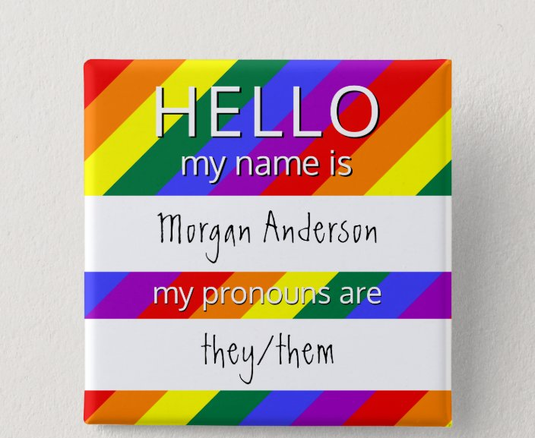
Example: Dray et al. (2020)
Research Question: Does participant likeability ratings of a fake coworker named Alex vary depending on Alex’s gender identity and sex assigned at birth?

Slide 6
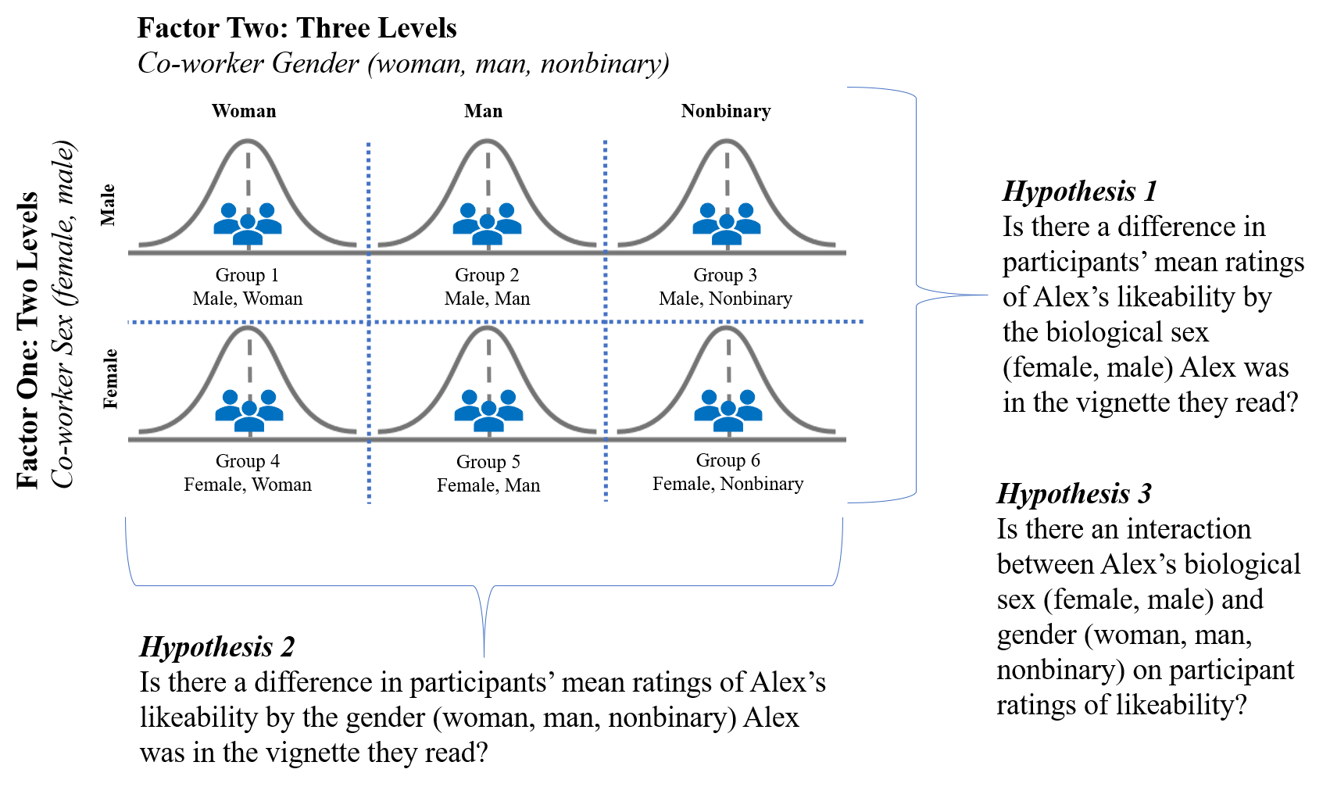
Factors and Hypotheses

Slide 7
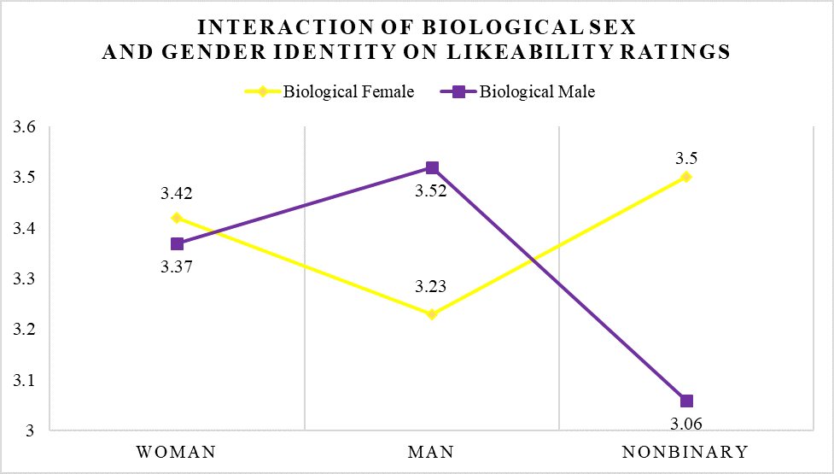
Dray et al. (2020) Findings
Notes:
Two-way ANOVA interactions are often easier to understand when they are presented graphically. Figure 7.2 below depicts the interaction between biological sex and gender identity on participant ratings of coworker likeability. Which group has the highest levels of likeability? Which group has the lowest level of likeability? Why do you think there is such a large difference between those two groups?
Dray and colleagues (2020) also found an interaction between Alex’s sex and gender on ratings of job performance, with the nonbinary vignettes receiving the lowest evaluations of job performance. This study shows that even when everything else is held constant, if people are given information about a coworker’s biological sex, gender, and gender expression, it impacts how likeable they perceive their coworkers to be as well as how they evaluate their coworker’s job performance.

Slide 8
Let’s think about it…
Why did the researchers use a two-way anova to answer their research question?
What do their results mean?
How would you improve this study?
Notes:
1. The researchers were interested in whether employee likeability varied depending on both the employee’s gender identity and sex assigned at birth. Because the dependent variable, likeability, was continuous, and both independent variables (gender identity and sex assigned at birth) were both categorical, a factorial ANOVA was the best statistic for this analysis. We will only cover two different statistical tests that have more than one independent variable, the two-way ANOVA and multiple regression, so if you have a study with two independent variables you will be using one of those tests. Independent variables with ANOVA are categorical, while independent variables with regressions are generally continuous.
2. The authors suggested a couple overall conclusions. Their results support that transgender and nonbinary workers are more likely to be perceived negatively in the workplace by the coworkers, particularly on evaluations of likeability and job performance. This was particularly true for nonbinary worker assigned a male sex at birth, showing how gender identity (woman, man, nonbinary) interacts with assigned sex at birth (male/female), to impact coworker perceptions. The authors suggest the results point to a need for employer anti-discrimination policies to protect trans and nonbinary workers. However, since this was a fictitious vignette study where participants read about the worker “Alex” outside of a real workplace context, more research is needed to understand how these findings translate to an actual workplace setting.
3. The authors pointed out multiple limitations of their study. First, they studied perceptions with vignettes – may not translate to a real workplace setting. Explicitly stating the worker’s assigned sex at birth and gender identity in the vignettes may have impacted participant perceptions; that information is not always explicitly stated or known in a workplace setting. It also means participant perceptions may not have been as holistic as they would be in a real workplace setting where additional context and experiences with the fictitious worker would presumably have an impact on perceptions. Perhaps showing fictitious worker performance ratings and evaluations by supervisors may be a way of adding performance context. Researchers did not provide participants a definition of intersex and gender expression; the lack of an operational definition of these terms may have impacted how participants interpreted and evaluated the fictitious employee. Gender identity was categorized into three groups (man, woman, nonbinary), which is limiting as not everyone’s gender identity falls into those three categories.

Slide 9
Factor One Hypotheses (Main Effect)
Null Hypothesis
Conceptual H_{0A}: There are no significant mean differences in DEPENDENT VARIABLE between LEVEL 1, LEVEL 2, LEVEL 3, …LEVEL_{k} of FACTOR 1.
Mathematical H_{0A}: There are no significant differences between the population means for LEVEL 1, LEVEL 2, LEVEL 3,…LEVEL_{k} on the dependent variable; M₁ = M₂ = M₃ … = M_{k}
Alternative Hypothesis
Conceptual H_{1A}: There are significant mean differences in DEPENDENT VARIABLE between LEVEL 1, LEVEL 2, LEVEL 3, …LEVEL_{k.} of FACTOR 1.
Mathematical H_{1A}: There are significant differences between the population means for LEVEL 1, LEVEL 2, LEVEL 3,…LEVEL_{k} on the dependent variable; M₁ ≠ M₂ ≠ M₃ … ≠ M_{k}

Slide 10
Factor Two Hypotheses (Main Effect)
Null Hypothesis
Conceptual H_{0A}: There are no significant mean differences in DEPENDENT VARIABLE between LEVEL 1, LEVEL 2, LEVEL 3, …LEVEL_{k} of FACTOR 1.
Mathematical H_{0A}: There are no significant differences between the population means for LEVEL 1, LEVEL 2, LEVEL 3,…LEVEL_{k} on the dependent variable; M₁ = M₂ = M₃ … = M_{k}
Alternative Hypothesis
Conceptual H_{1A}: There are significant mean differences in DEPENDENT VARIABLE between LEVEL 1, LEVEL 2, LEVEL 3, …LEVEL_{k.} of FACTOR 1.
Mathematical H_{1A}: There are significant differences between the population means for LEVEL 1, LEVEL 2, LEVEL 3,…LEVEL_{k} on the dependent variable; M₁ ≠ M₂ ≠ M₃ … ≠ M_{k}

Slide 11
Interaction Hypotheses
Null Hypothesis
Conceptual H_{0AB}: There is not a significant interaction between FACTOR 1 and FACTOR 2 on the DEPENDENT VARIABLE.
Mathematical H_{0AB}: FACTOR 1 x FACTOR 2 = 0 for each cell.
Alternative Hypothesis
Conceptual H_{1AB}: There is a significant interaction between FACTOR 1 and FACTOR 2 on the DEPENDENT VARIABLE.
Mathematical H_{1AB}: FACTOR 1 x FACTOR 2 ≠ 0 for at least one cell.

Slide 12
Assumptions
Categorical Independent Variable (IV)
Continuous Dependent Variable (DV)
Independent Observations
Normal Distribution
No Outliers
Homogeneity of variance
Notes:
Same assumptions as the Independent Samples t Test

Slide 13
Categorical Independent Variables (IVs)
IV must be:
Measured at the nominal level
Two or more groups

Slide 14
Continuous Dependent Variable (DV)
DV must be:
Continuous
Measured at the interval or ratio level
E.g., height, weight, Beck Depression Inventory, Big Five personality inventory, etc.

Slide 15
Independent Observations
Participants in all groups/cells are different
A
B
C
D
E
F
G
H
I
J
K
L
Condition A
Condition B
Condition C

Slide 16
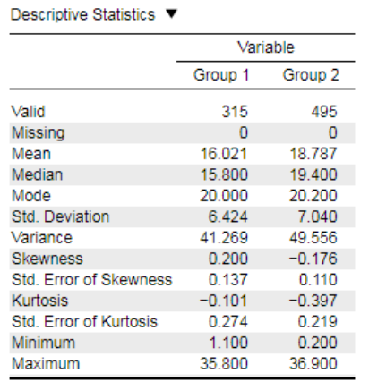
Normal Distribution
Dependent variable is normally distributed within each group
Want Skewness and Kurtosis Statistics between -2 and +2
Notes:
https://static.jasp-stats.org/Statistical%20Analysis%20in%20JASP%20-%20A%20Students%20Guide%20v1.0.pdf

Slide 17
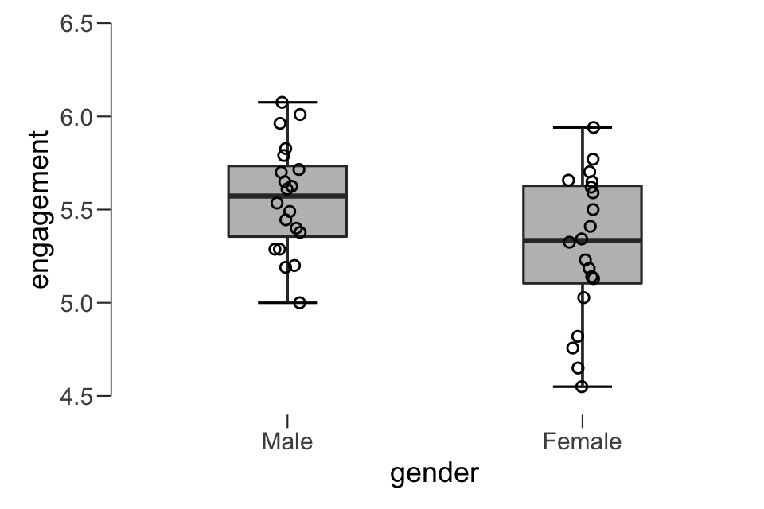
No Outliers
Outliers are visible on boxplots when data points are located more than 1.5 box-lengths from the “whiskers” of the box

Slide 18
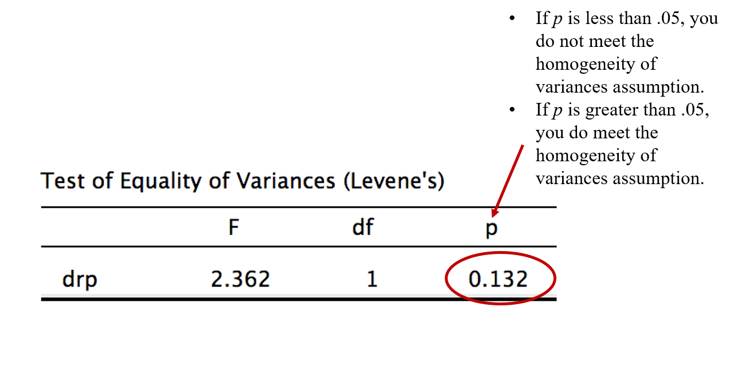
Homogeneity of variance
Need to check that the variance of your two groups are equal
Levene’s Test

Slide 19
Effect Size: Omega squared (ω²)
Effect Size | Strength
.01 | Small
.06 | Medium
.14 | Large

Slide 20
How many steps will it take to conduct a two-way ANOVA?
Check your six statistical assumptions
Interpret the main effect for Hypothesis 1
If p < .05, reject null hypothesis and conclude you have a significant main effect.
If p > .05, fail to reject null hypothesis and conclude you do not have a main effect.
Interpret the main effect for Hypothesis 2
If p < .05, reject null hypothesis and conclude you have a significant main effect.
If p > .05, fail to reject null hypothesis and conclude you do not have a main effect.
Interpret the interaction effect for Hypothesis 3
If p < .05, reject null hypothesis and conclude you have a significant interaction.
If you have a significant interaction, proceed to run and interpret Simple Main Effects.
If p > .05, fail to reject null hypothesis and conclude you do not have a significant interaction.

Slide 21
Walk-Through Example
The Pew Research Center collected and published survey data on attitudes toward women in leadership as part of their American Trends Panel Survey in 2018. This report detailed the findings from a sample of 4,587 participants who completed an online survey. As part of their report, Parker, Horowitz, and Igielnik (2018) discussed the disparities in attitudes toward women in leadership positions – both in political and corporate settings – by gender, political party, and age. For example, they reported that the majority of women said gender discrimination is a major reason there aren’t more women in high political offices and top executive business positions; however, only 36% of men agreed it was an issue for high political offices and 44% for top executive business positions. When they looked at gender and age together, the majority of women agreed gender discrimination in a barrier to leadership across all ages, while only 35% of men 18-49 years old agreed and 38% of men 50 years and older agreed. We are going to follow up on their analyses by taking a more nuanced look at the interaction between age and gender on attitudes toward women in leadership using their data set – specifically, we are going to focus on women in political positions.

Slide 22
Pew Research Center American Trends Panel Survey (2018)
 | Factor Two: Age
Factor One: Gender | Younger Adult 30-49yrs (Level 1) | Middle-Aged Adult 50-64yrs (Level 2) | Older Adult 65yrs+ (Level 3)
Woman (Level 1) | Younger adult, Woman | Middle-aged adult, Woman | Older adult, Woman
Man (Level 2) | Young adult, Man | Middle-aged adult, Man | Older adult, Man
2x3 Factorial Design

Slide 23
Do attitudes toward women in leadership positions vary depending on a participant’s gender and age?
Research Question

Slide 24
What do you think we will find when we analyze the data?
What are your hypotheses?

Slide 25
Hypotheses: Factor One (Main Effect of Gender)
H₀:There are no significant mean differences in favorable attitudes toward women in politics between women and men.
H₁:There is a significant mean difference in favorable attitudes toward women in politics between women and men.

Slide 26
Hypotheses: Factor Two (Main Effect of Age)
H₀:
H₁:
Notes:
Conceptual H_{0B}: There are no significant mean differences in favorable attitudes toward women in politics between the three age groups.
Conceptual H_{1B}: There is a significant mean difference in favorable attitudes toward women in politics between the three age groups.

Slide 27
Hypotheses: Interaction between Gender and Age Group (Factor One x Factor Two)
H₀:
H₁:
Notes:
Conceptual H_{0AB}: There is not a significant interaction between gender and age on favorable attitudes toward women in politics.
Conceptual H_{1AB}: There is a significant interaction between gender and age on favorable attitudes toward women in politics.

Slide 28
Let’s Analyze the Data!
Notes:
This Photo by Unknown Author is licensed under CC BY-ND

Slide 29
Creative Commons License
Notes:
CC BY-NC-ND: This license allows reusers to copy and distribute the material in any medium or format in unadapted form only, for noncommercial purposes only, and only so long as attribution is given to the creator.

