Slide 1
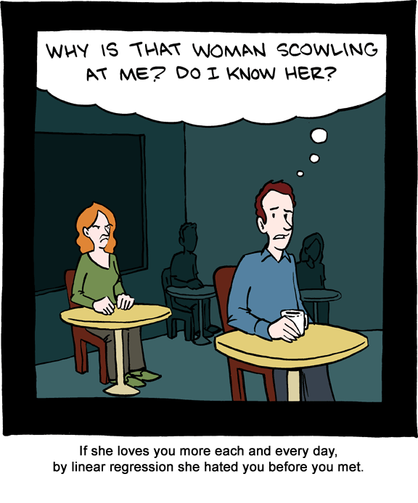
Chapter ?
Regression

Slide 2

Learning Objectives
Teach statistical thinking
  Students will be able to state the null and alternative hypotheses for a linear regression analysis.
  Students will understand the appropriate use of a linear regression analysis.
  Students will know how to accurately write the results of a simple and multiple linear regression analysis.
Focus on conceptual understanding
  Students will know how to interpret the results of a simple and multiple regression analysis.
Students will be able to translate the results of a linear regression into real world meaning.
Use technology to explore concepts and analyze data
  Students will know how to test that the dataset meets the assumptions needed to run a linear regression.
  Students will know how to run linear regression in JASP.

Slide 3
What is a regression?
A linear regression analyzes linear relationships between continuous variables,
Sounds like correlation… What’s the difference?
  Regression is built for prediction, where we specify an outcome (Y) to be predicted based on values of a predictor (X) or set of predictors (X1, X2, …).
  You can use more than one predictor in order to explain differences in Y when we use multiple regression.
  Regression provides an unstandardized estimate of the relationship. Whereas a correlation only ranges from -1 to 1, the slope coefficient is in the original units of the variable.

Slide 4

Disclaimer
Just because we label variables a predictor and outcome does not allow us to make inferences about X truly causing Y. The same principles we learned related to “correlation is not causation” still apply here. Establishing causality really comes down to our research design, not the type of analysis we use.

Slide 5
The best-fit line (linear equation)
Slope
“Rise over run” strength of the relationship between the predictor (x) and outcome (y).
We interpret the value as, for every one-unit increase in X, you expect _ increase or decrease in Y.
Intercept
The y-intercept is the point where the line crosses the y-axis.
We can think of this as an anchoring point. When you are zero on X, what would be your value on Y?
Can be positive or negative (like a positive or negative correlation)
b represents the unstandardized slope, beta (β) represents the standardized slope, which ranges from -1 to +1 just like a correlation
Y = slope (X) + Intercept

Slide 6
Regression Example
X (years of education) | Linear Equation | Predicted salary (Y)
0 (the intercept) | $10,000 (0) + $29,000 | $29,000
1 | $10,000(1) + $29,000 | $39,000
2 | $10,000(2) + $29,000 | $49,000
3 | $10,000(3) + $29,000 | $59,000
4 | $10,000(4) + $29,000 | $69,000
5 | $10,000(5) + $29,000 | $79,000
Salary = slope (education in years) + intercept
Adding some values…
Salary = $10,000 (education in years) + $29,000

Slide 7
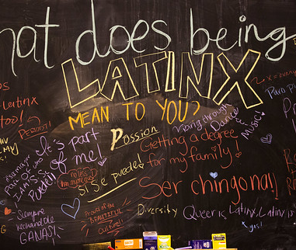
Research Example (Suáreaz-Orozco & López Hernández, 2020)
Suáreaz-Orozco and López Hernández (2020) analyzed survey data that came from 486 undocumented Latinx undergraduate students. They found evidence that undocumented students experienced anxiety levels that far exceeded typical rages (4 times higher than the general population for females and 7 times higher for males). They wanted to understand what contributed to anxiety among undocumented students. In other words, they wanted to assess predictors of the outcome of interest, anxiety.
This Photo by Unknown Author is licensed under CC BY-SA-NC

Slide 8
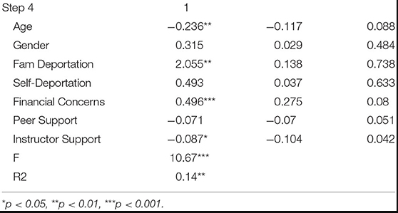
Table 2 (Suáreaz-Orozco & López Hernández, 2020)
Notes:
Let’s take a moment to look at the results table from their research article. The left column shows you the list of variables the researchers included in their regression model to predict anxiety in undocumented Latinx students. They included age, gender, fear of their family being deported, fear of themselves being deported, financial concerns, support from their peers, and support from their instructors. The numbers in the second row that have an asterisk next to them indicate predictor variables that are significant in our model. Numbers that are negative, indicate a negative relationship between that variable and student anxiety. Numbers that are positive, indicate a positive relationship between that variable and student anxiety. Thus, age is negatively related to anxiety. The older the student is, the less anxiety symptoms they report.
Instructor support is also negative. Can someone explain what that means? There is a negative slope (-.09). Meaning that for every one-unit increase in instructor support, there was a .09 decrease in anxiety.
Alternatively, fear of family deportation and financial concerns are both significantly and positively related. As financial concerns increase, so does student anxiety. Can someone explain the relationship between fear of family deportation and anxiety? They found that the slope for the predictor, fear of family deportation, was 2.05. This means for every one-unit increase in fear of family members’ deportation, there was a 2.05 increase in anxiety.

Slide 9
Let’s think about it…
Why did the researchers use a regression to answer their research questions?
What do their results mean?
How would you improve this study?
Notes:
1. The researchers wanted to see how multiple variables predicted anxiety in undocumented Latinx students. The use of multiple, continuous variables, to predict a continuous variable necessitated the use of multiple regression.
2. The authors found multiple things, including: The rates of self-reported anxiety for undocumented Latina students were 4 times that of the norm population; that of undocumented Latino students was 7 times higher. In terms of predicting anxiety, age, fear of family deportation, financial concerns, and instructor support all predicted student anxiety levels. Students who were older, had less financial concerns, had more instructor support, and less fear of family deportation had lower levels of anxiety. Support from peers, fear of self-deportation, and gender did not predict anxiety.
3. The authors point out multiple limitations of this study. The sample is not random, and there are more students attending 4-year colleges than 2-year community colleges represented. The sample is from California, a state that is particularly friendly to undocumented people compared to other states. Levels of anxiety may be very different in states without protections for undocumented people (e.g., Arizona, Georgia, South Carolina).

Slide 10
Multiple Regression
When we just use one predictor, we often call it a simple regression and when we use two or more predictors to explain a single outcome, we use a multiple regression.
Here’s an example of the generic format for a multiple regression with two predictors (X1 and X2) and the example with our variables predicting salary.
  Y = Slope 1 (X1) + Slope 2 (X2) + intercept
  Salary = $10,000 (education in years) + $50 (networking skills) + $29,000
We could then plug in X scores to predict salary. For instance, if someone has 3 years of education after high school and scores a 40 out of 100 in networking skills, we would find that they would be expected to have a salary of $61,000.
  Salary = $10,000 (3) + $50 (40) + $29,000
  = $61,000

Slide 11

When do researchers use regression?
Researchers use linear regression when they are interested in explaining a continuous outcome variable using a continuous predictor.
They use multiple regression when they want to see the combined influence of two or more continuous predictors on a continuous outcome.

Slide 12
Hypotheses
If we are looking at two or more variables, we often want to know if those variables are doing a good job at explaining our outcome. We test overall how good our prediction model is with an F test.
What we are usually more interested in is testing the significance of the slopes of our predictors, trying to determine if the slope is different than zero.
The null hypothesis is:
  Conceptual H₀: The predictor variable is not related to the outcome variable.
  Mathematical H₀: b = 0
The alternative hypothesis is:
  Conceptual H₁: The predictor variable is related to the outcome variable.
  Mathematical H₁ : b ≠ 0

Slide 13
Assumptions
1. Continuous variables
2. Normal Distribution
3. No outliers
4. Linearity
5. Heteroscedasticity and Normality of Residuals
(Multiple regression only) 6. Multicollinearity

Slide 14
Assumption 1: Continuous Variables
Both your predictor and outcome should be continuous (interval or ratio) to be able to interpret slopes.
*Disclaimer: You can include nominal variables in regression, but it’s done with a technique called dummy coding that is beyond what we cover in this class.

Slide 15
Assumption 2: Normal Distribution
Both your variables should be approximately normally distributed.
Check this with…
  Histograms
  Skewness and Kurtosis values (should not exceed +/- 2)

Slide 16
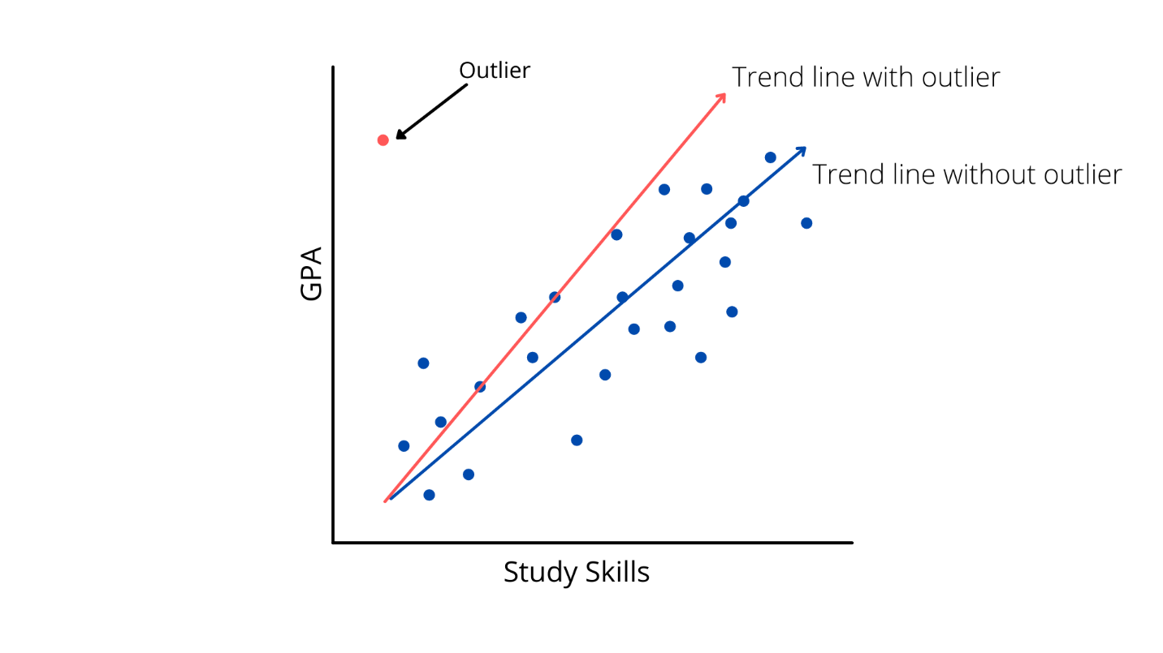
Assumption 3:
Outliers
We want to check both variables for outliers. You can spot outliers with a boxplot.
We also want to look for multivariate outliers in a scatterplot.

Slide 17
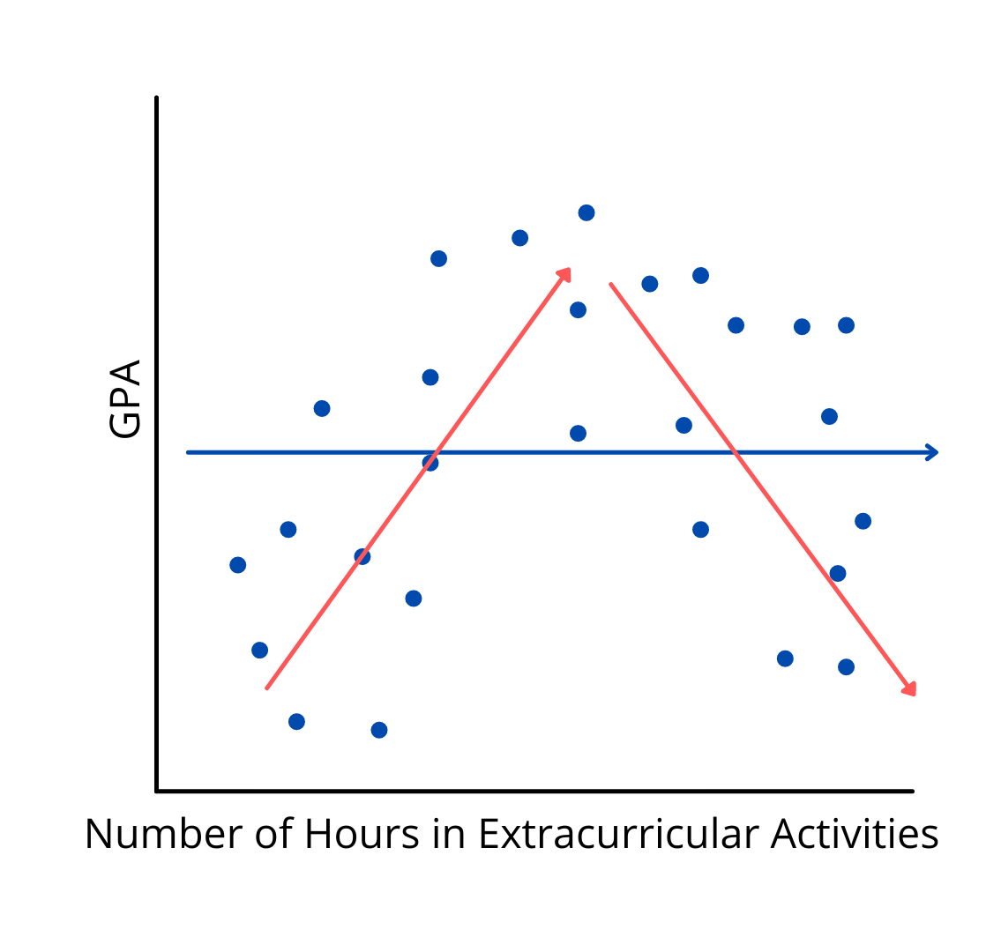
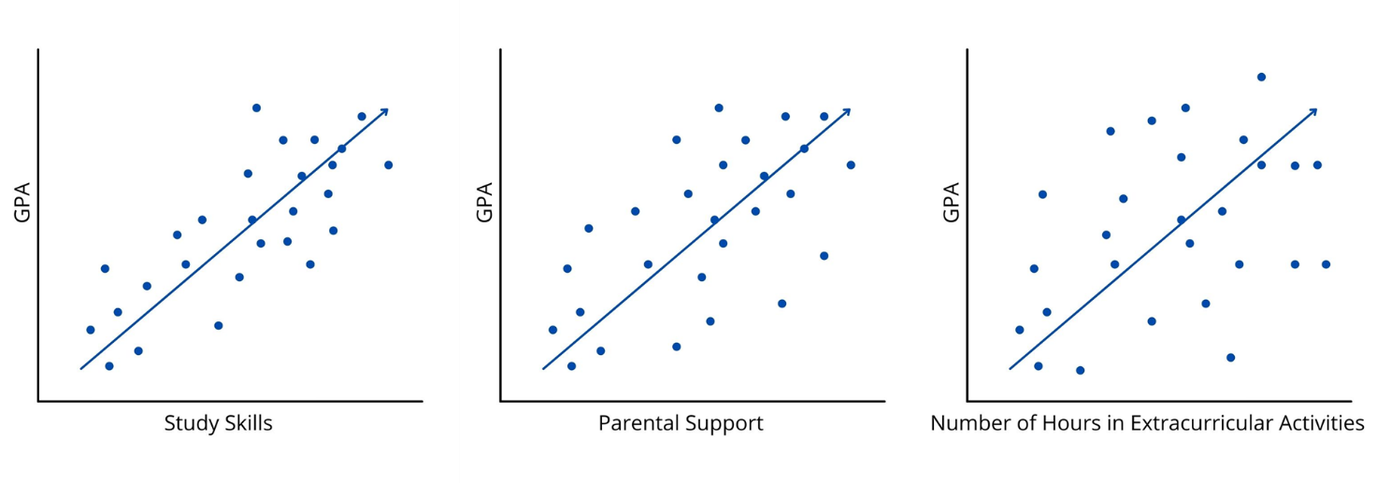
Assumption 4: Linearity
The relationship needs to follow a line-like pattern.
If it does not follow a straight line trend, it will not be captured well with a linear model and other approaches are needed.
This assumption can also be checked by looking at a scatterplot.

Slide 18
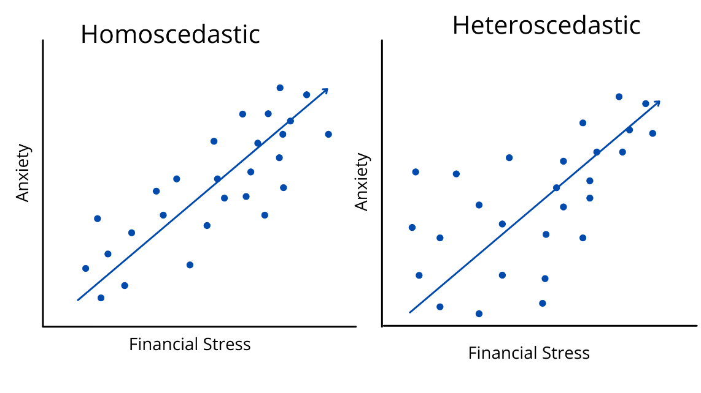
Assumption 5: Heteroscedasticity and Normality of Residuals
Heteroscedasticity is about whether we have equal error variances across all values of our predictor. That means that the variance in our errors should be similar across all values of our X variable.
Look for strange shapes in a scatterplot (e.g., cone shape)

Slide 19
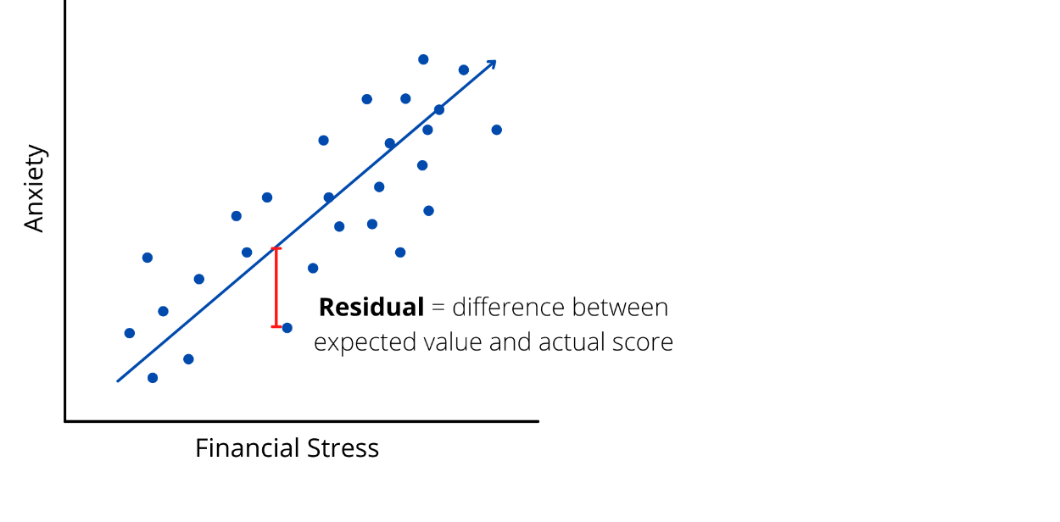
Assumption 5: Heteroscedasticity and Normality of Residuals
Normality of Residuals
A residual is the difference between what we would expect someone to score on Y, given their value on X, and what they actually score.
We request a histogram of the residuals for all of our data in the model in our JASP regression menus.
A normal distribution of residuals would mean that most of the time we have relatively little prediction error, and larger prediction errors are less common.

Slide 20
Assumption 6: Multicollinearity
This one just applies to a multiple regression, where we have more than one predictor.
Multicollinearity is a concern when your predictor variables are too correlated with one another.
Ways to assess this are…
1. Look at the basic correlations between predictors (correlations should not exceed .80)
2. Look at Variance Inflation Factor in the regression output (should be less than 10)

Slide 21
Statistical Significance in a Regression
Statistical Significance of the Model
Model significance concerns whether our best-fit line, which can include one or more predictors, is doing a good job at explaining variation in our outcome.
Statistical Significance of the Slope(s)
The significance of slope coefficients is indexed by a t-value.
Indexed by an F value, which compares the proportion of variance explained by our model compared to the residual variance, or what is not explained by our model.
An F value will have an associated p-value that helps us determine significance (i.e., whether the null is very unlikely to be true given the data).
The slope value calculated (b) is compared to 0 to determine if the value is significantly bigger than zero.
The associated p-value that tells us if the slope is large enough to be considered significantly different from zero.

Slide 22
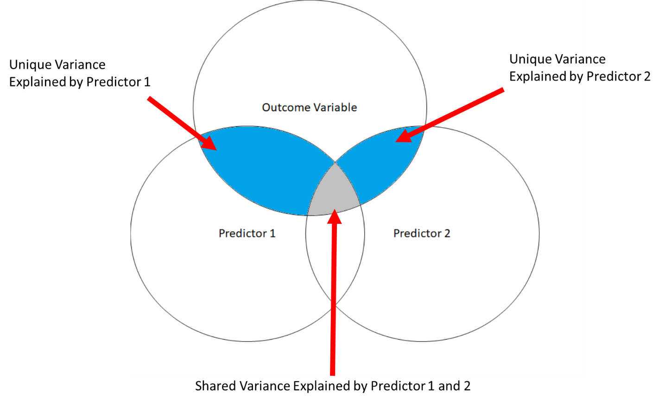
Practical Significance in a Regression
We look at r² for the effect size for a single predictor and Multiple R squared (R²) for the combined effect of two or more predictors.
As an example, Suáreaz-Orozco and López Hernández (2020) included seven different predictors in their regression model. They found that together, the value for R² was .14, meaning that together the seven predictors explained 14% of the variance in anxiety experienced by undocumented Latinx students.

Slide 23

JASP Walk-Through Example
We are going to use a portion of the data that was used in the study by Li, Wu, and Xiong (2021). This is the same study we used when we conducted a Pearson Correlation in the previous guide and found a strong, positive relationship between employee levels of cultural intelligence (e.g., ability to adapt to cross-cultural environments) and their innovative behaviors in the workplace. We will be building upon that analysis by conducting a multiple regression to examine how and if Cultural Intelligence, Organizational Culture Differences, and Knowledge Sharing predict our dependent variable, Sustainable Innovation Behavior.

Slide 24
Our Variables
Dependent Variable
Sustainable Innovation Behavior (SIB): six questions rated on a 7-point likert scale. Higher scores on this scale indicate higher levels of innovative behavior. A sample item includes, “I often come up with creative ideas.”
Independent Variables
Cultural Intelligence (CQ): 12 questions rated on a 7-point likert scale. Higher scores on this scale indicate higher levels of Cultural Intelligence. A sample item includes, “I vary the rate of my speaking when a cross-cultural situation requires it.”
Organizational Culture Behavior (OCB): 5 questions rated on a 7-point Likert scale. Higher scores on this scale indicate higher levels of Organizational Culture Behavior. A sample item includes, “Organizations uses consensus seeking rather than authoritarian decision making.”
Knowledge Sharing (KS): 4 questions rated on a 7-point Likert scale. Higher scores on this scale indicate higher levels of Knowledge Sharinh. A sample item includes, “The more knowledgeable members will provide the other members with knowledge or skills that are difficult to acquire for free.”

Slide 25

Research Question
Does Cultural Intelligence, Organizational Culture Differences, and Knowledge Sharing predict Sustainable Innovation Behavior in the workplace?

Slide 26

What do you think we will find when we analyze the data?
What are your hypotheses?
Notes:
Will all of the independent variables be good predictors?

Slide 27
Hypotheses
Null hypothesis:
Alternative hypothesis:
Notes:
What are our study hypotheses? How would we write them?
The null hypothesis is:
Conceptual H₀: Cultural Intelligence, Knowledge Sharing, and Organizational Culture Differences will not predict Sustainable Innovation Behavior.
Mathematical H₀: b = 0
The alternative hypothesis is:
Conceptual H₁: Cultural Intelligence, Knowledge Sharing, and Organizational Culture Differences will predict Sustainable Innovation Behavior.
Mathematical H₁: b $≠$ 0

Slide 28
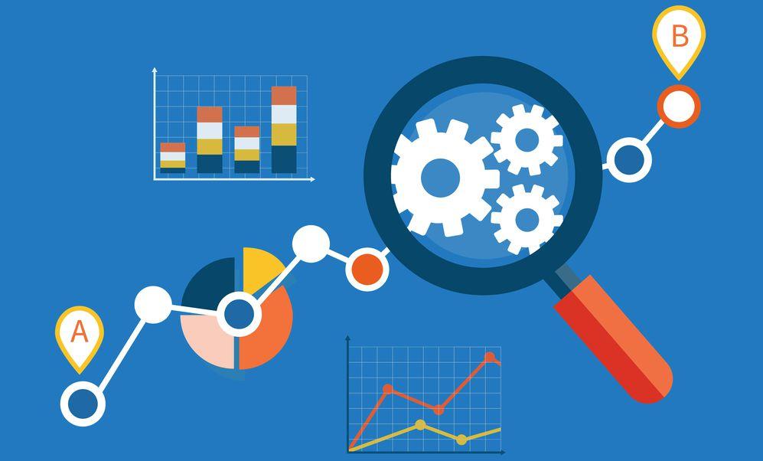
Let’s Analyze the Data!
Notes:
This Photo by Unknown Author is licensed under CC BY-ND

Slide 29

Creative Commons License
Notes:
CC BY-NC-ND: This license allows reusers to copy and distribute the material in any medium or format in unadapted form only, for noncommercial purposes only, and only so long as attribution is given to the creator.

