Slide 1
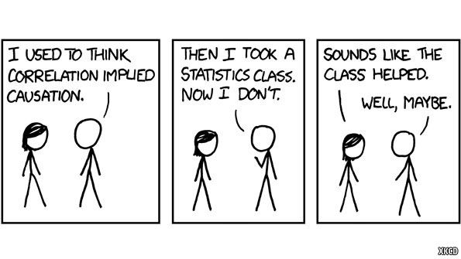
Chapter ?
Correlation

Slide 2

Learning Objectives
Teach statistical thinking
  Students will be able to state the null and alternative hypotheses for a correlational analysis.
  Students will understand the appropriate use of correlations.
  Students will know how to accurately write the results of a correlational analysis in APA format.
Focus on conceptual understanding
  Students will know how to interpret the results of a correlational analysis, including the strength and direction indicated by the Pearson’s correlation coefficient.
  Students will appropriately interpret a correlation, with an understanding that correlation does not imply causation.
Students will be able to translate the results of a correlation into real world meaning.
Use technology to explore concepts and analyze data
  Students will know how to test whether their variables and data meet the assumptions needed to run a correlation.
  Students will know how to run a correlation in JASP.

Slide 3
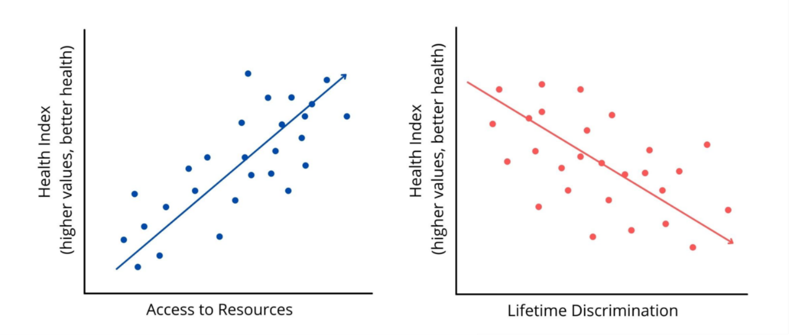
What is a correlation?
A correlational analysis is used to examine whether there is a relationship between two continuous variables.
Correlations can be positive or negative in direction

Slide 4
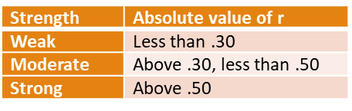
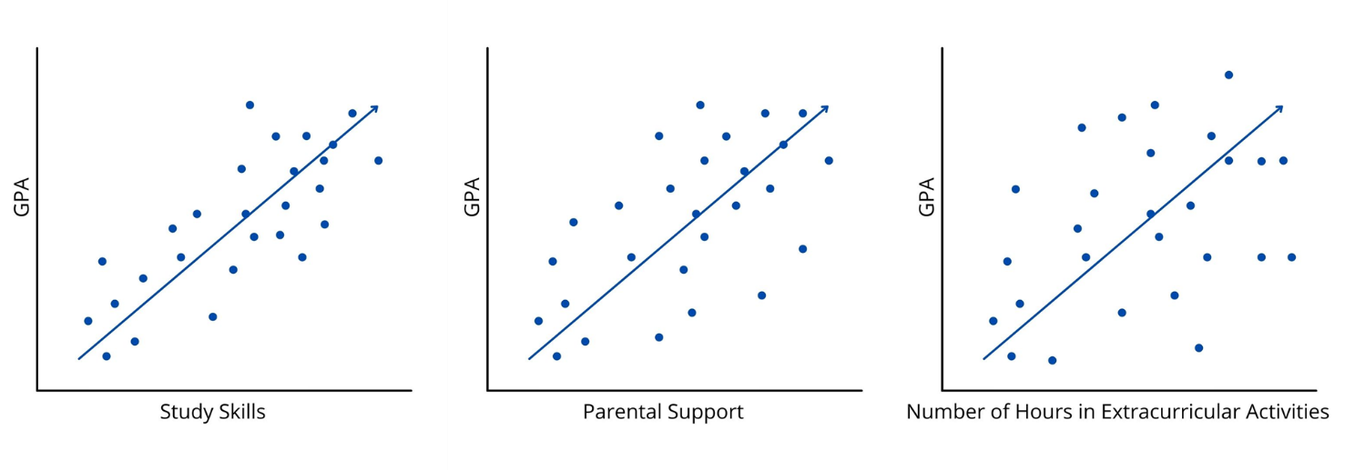
Correlations vary in strength
Pearson’s r, the typical value we use to report a correlation, ranges for -1 to +1

Slide 5
Example from Jaramillo et al., (2016)
Jaramillo et al., (2016) examined how ethnic identity, perceived discrimination and stereotype threat related to academic achievement and hopelessness in 129 Native American high school students. Specifically, they measured:
Ethnic Identity: 6-item, 4-point likert scale assessing strength of ethnic identity
Stereotype Threat: 3-item, 7-point likert scale assessing concern that ethnic identity impacts academic performance
Perceived Discrimination: 10-item, 5-point likert scale measuring how often they are treated unfairly because of the ethnic identity
Academic Achievement: grade point average
Hopelessness: 17-item, 5-point likert scale assessing feelings of hopelessness
Notes:
Jaramillo et al., (2016) were interested in disparities in academic achievement among Native American adolescents. Diversity-related research on Native American populations is pretty scarce, yet available data suggest that Native Americans experience a disproportionate number of adverse outcomes in terms of health and education.

Slide 6
Correlation Table (Adapted from Jaramillo et al., 2016)
Variable | 1 | 2 | 3 | 4
1. Ethnic Identity | -
2. Stereotype Threat | -.06 | -
3. Perceived Discrimination | .18* | .18* | -
4. Academic Achievement | .08 | -.09 | -.01 | -
5. Hopelessness | .01 | .34* | .23* | -.20*
Notes:
Note that the table on the slide is adapted from Jaramillo et al. (2016) and is in APA format. Discuss how to interpret an APA style correlation table.
Numbers with an asterisk indicate a significant correlation.
Significant negative numbers indicate a negative correlation. Both variables are moving in opposite directions. As one goes up, the other goes down.
Significant positive numbers indicate a positive correlation. Both variables are moving in the same direction. As one goes up, the other goes up as well.

Slide 7
What significant correlations did Jaramillo et al. (2016) find?
Variable | 1 | 2 | 3 | 4
1. Ethnic Identity | -
2. Stereotype Threat | -.06 | -
3. Perceived Discrimination | .18* | .18* | -
4. Academic Achievement | .08 | -.09 | -.01 | -
5. Hopelessness | .01 | .34* | .23* | -.20*
Notes:
Discuss each of the findings.
Perceived discrimination is positively correlated with ethnic identity. This means that students who reported they were treated unfairly because of their racial/ethnic group were also more likely to report that they had a stronger ethnic identity.
Perceived discrimination is positively correlated with stereotype threat. This means that students who reported they were treated unfairly because of their racial/ethnic group were also more likely to report that they worry about their ability to perform academically is impacted by their ethnicity.
Hopelessness is positively correlated with stereotype threat. What does that mean?
Students who are more likely to report that they worry about their ability to perform academically is impacted by their ethnicity are also more likely to report that they had feelings of hopelessness.
Hopelessness is also positively correlated with perceived discrimination. This means that students who reported they were treated unfairly because of their racial/ethnic group were also more likely to report that they had feelings of hopelessness.
Finally, hopelessness was negative correlated with academic achievement. What does that mean?
Students who had a higher-grade point average (GPA), were less likely to report that they had feelings of hopelessness.
The authors were interested in understanding academic achievement. What do you notice about what academic achievement was correlated with, versus what it was not correlated with?
GPA was NOT related to ethnic identity, stereotype threat, or perceived discrimination.
GPA was ONLY related to feelings of hopelessness, which may be a possible indication of depression.

Slide 8
Let’s think about it…
Why did the researchers use Pearson correlations to answer their research questions?
What do their results mean?
How would you improve this study?
Notes:
1. Because they were interested in understanding the relationships between pairs of continuous variables.
2. The authors ran more advanced statistical analyses. In their additional analyses, they found that Native American adolescents with low ethnic identity and high perceived discrimination had the highest rates of hopelessness. They also found that participants who reported both high ethnic identity and low stereotype threat had higher grade point averages. However, more research is needed to better understand the implications of this study.
3. The sample size of 129 Native American adolescents is low. Additionally, all participants were from the same high school and had lower SES, which limits how generalizable the results are to other Native American adolescents. They also used GPA as an indicator of academic achievement. Rather than having only one item to indicate academic achievement, it would be good to use a standardized test or teacher reports, or multiple methods. Longitudinal research to understand how the process of ethnic identification may impact academic achievement rather than a one-time measurement would be informative.

Slide 9
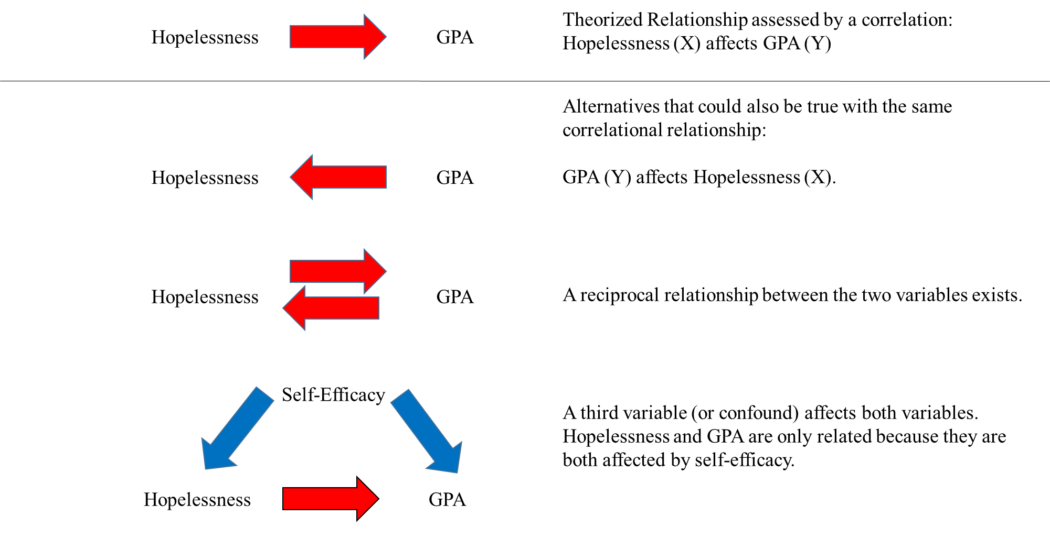
But remember, Correlation is NOT causation

Slide 10

When do researchers use correlations?
A correlation would be the primary analysis if a researcher is interested in the general relationship between two continuous variables.
Correlations are very common in social science research.
Many times, it is one of the first things researchers check when they have measured a number of continuous variables that they believe would be related to each other.

Slide 11
Hypotheses
The null hypothesis is:
  Conceptual H₀: Variable A is not related to Variable B.
  Mathematical H₀: r = 0
The alternative hypothesis is:
  Conceptual H₁: Variable A is related to Variable B.
  Mathematical H₁: r ≠ 0

Slide 12
Assumptions
1. Continuous variables
2. Normal Distribution
3. No outliers
4. Linearity

Slide 13
Assumption 1: Continuous Variables
Both your predictor and outcome should be continuous (interval or ratio)
If you have ordinal variables, you can use the Spearman rank-order correlation
Categorical variables do not make much sense in correlations

Slide 14
Assumption 2: Normal Distribution
Both your variables should be approximately normally distributed.
Check this with…
  Histograms
  Skewness and Kurtosis values (should not exceed +/- 2)

Slide 15
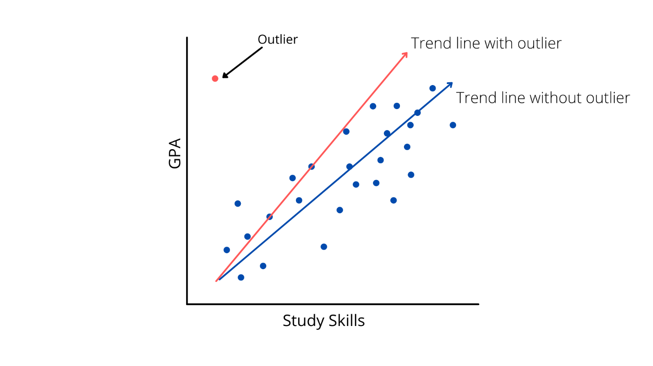
Assumption 3:
Outliers
We want to check both variables for outliers. You can spot outliers with a boxplot.
We also need to look for multivariate outliers, meaning the combination of scores on the two variables is odd, even if the individual scores are still relatively normal.
We can spot multivariate outliers in a scatterplot

Slide 16
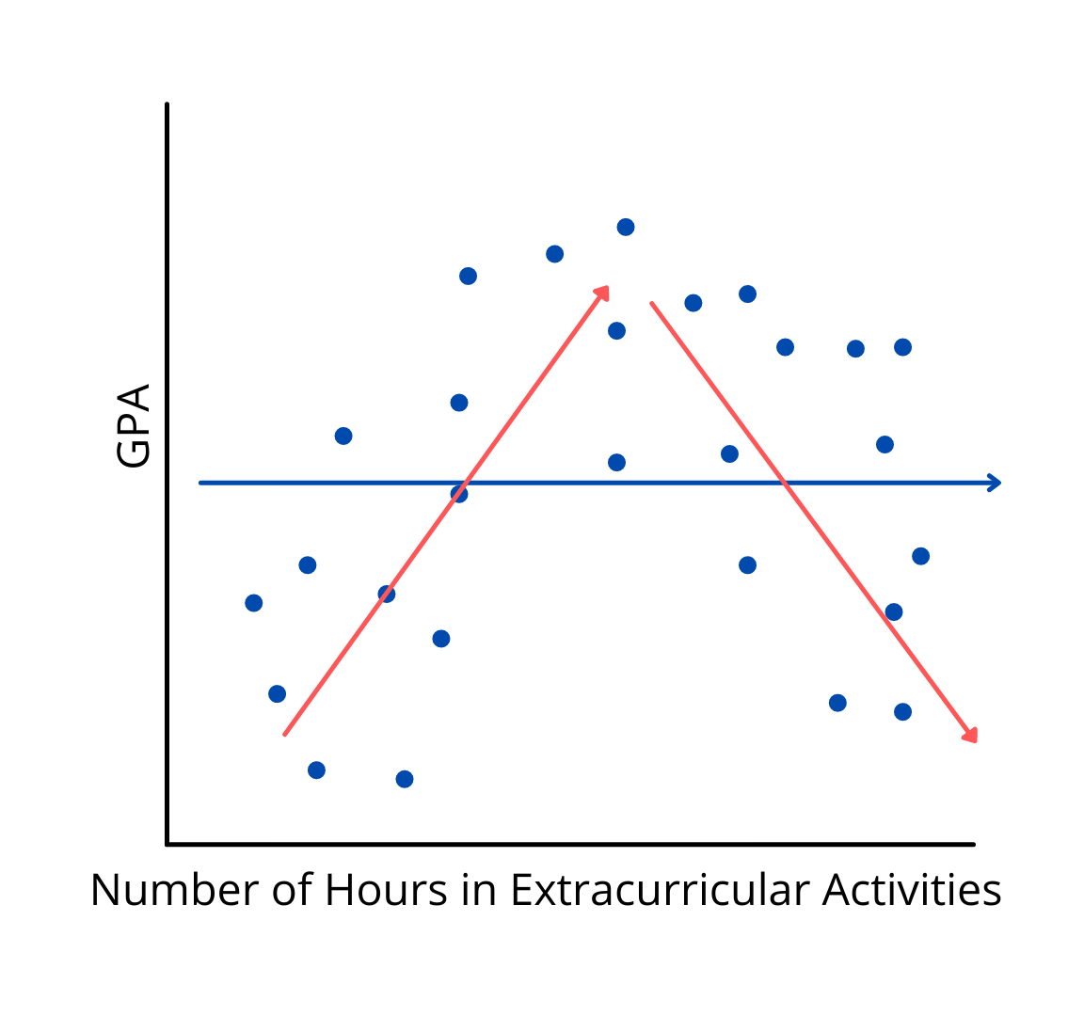
Assumption 4: Linearity
The relationship needs to follow a line-like pattern.
If it does not follow a straight line trend, it may not be captured well by a correlation.
This assumption can also be checked by looking at a scatterplot.

Slide 17
Significance of a Correlation
Statistical Significance
When a correlation is statistically significant, it means it is different from zero. We reject the null that there is no relationship between the variables (i.e., r is not 0), in favor of our alternative hypothesis.
If your correlation coefficient has a p value smaller than .05, we would reject our null and say the correlation is significant.
Practical Significance
r value itself is an effect size
r² → Square the correlation to interpret as a percentage of variance overlapping between variables
Example: Jamillo et al. (2016) found that the correlation between stereotype threats and hopelessness was r = .34, r² = .12. This means that approximately 12% of the variance in hopelessness (why some students feel more hopeful than others) can be explained by stereotype threats.

Slide 18
Walk-Through Example
Researchers Li, Wu, and Xiong (2021) published a study in the open-access journal, PLoS ONE, to understand the relationship between employee levels of cultural intelligence and their innovative behaviors in the workplace. Past researchers have found that an employee’s ability to adapt to cross-cultural environments is associated with better job performance in culturally diverse settings (Ang et al., 2006). There has been a lack of research into the relationship between cultural intelligence and sustainable innovation behavior; however, past research in this area has found a relationship between cultural intelligence and employee adaptive work behavior (Pandey & Charoensukmongkol, 2019), employee creativity (Hu et al., 2017), and an organizations’ ability to create and adopt innovations (Gölgeci et al., 2017). Li and colleagues (2021) focused on studying the relationship between employee cultural intelligence and sustainable innovation behavior, defined as “The act of generating new ideas and translating those ideas into practice” (p. 4).

Slide 19
Let’s focus on the following variables from Li et al. (2021)
Sustainable Innovation Behavior (SIB): six questions rated on a 7-point likert scale. Higher scores on this scale indicate higher levels of innovative behavior. A sample item includes, “I often come up with creative ideas.”
Cultural Intelligence (CQ): 12 questions rated on a 7-point likert scale. Higher scores on this scale indicate higher levels of Cultural Intelligence. A sample item includes, “I vary the rate of my speaking when a cross-cultural situation requires it.”

Slide 20

Research Question
Is there a positive relationship between employees’ cultural intelligence and sustainable innovation behavior?

Slide 21

What do you think we will find when we analyze the data?
What are your hypotheses?

Slide 22
Researcher Hypotheses
Null Hypothesis:
Alternative Hypothesis:
Notes:
The null and alternative hypothesis would be:
H₀: Employee cultural intelligence will be unrelated to sustainable innovation behavior; or r = 0.
H₁: Employee cultural intelligence will be significantly related to sustainable innovation behavior; or r ≠ 0

Slide 23

Let’s Analyze the Data!
Notes:
This Photo by Unknown Author is licensed under CC BY-ND

Slide 24

Licensed through Creative Commons
Notes:
CC BY-NC-ND: This license allows reusers to copy and distribute the material in any medium or format in unadapted form only, for noncommercial purposes only, and only so long as attribution is given to the creator.

