Slide 1
Chapter ? One Way ANOVA

Slide 2
Learning Objectives
Teach statistical thinking
Students will be able to state the null and alternative hypotheses for a one-way analysis of variance (ANOVA)
Students will understand the appropriate use of one-way ANOVAs
Students will know how to accurately write the results of one-way ANOVAs in APA format
Focus on conceptual understanding
Students will know how to interpret the results of a one-way ANOVA
Students will be able to translate the results of one-way ANOVAs into real-world meaning (i.e., how would you explain the results to someone not in this course?)
Use technology to explore concepts and analyze data
Students will know how to test that the dataset meets the assumptions needed to run one-way ANOVAs
Students will know how to run a one-way ANOVA in JASP

Slide 3
Background (Meyer et al., 2021)
People of sexual and gender minority experience hostile social environments due to stigma, prejudice, and discrimination
These hostile social environments contribute to mental and physical health disparities among these groups
Rooted in social stress theory which proposes that people of minority social statuses experience social stressors which lead to greater experiences of physiological and psychological stress, which contributes to increased risk of mental and physical health problems
Since the 1950s in the US, there has been increased visibility of LGBTQ+ populations and greater legal protections implemented to protect their rights

Slide 4
Background (Meyer et al., 2021) cont.
Research question: If social environments have improved, do we see a decrease in social stress and physical and mental health concerns among LGBTQ+ individuals?
Are there differences in mean levels of everyday discrimination between the Pride, Visibility, and/or Equality Cohorts?
Design: Participants divided into three generational cohorts (Pride, born 1956-1963; Visibility, born 1974-1981; Equality, born 1990-1997)
Analysis: One-way ANOVA
Results: Researchers found significant group differences between all groups
The equality cohort experienced greater discrimination (M = 2.15, SD = 0.03) than the visibility cohort (M = 2.00, SD = 0.05), p < 0.01, and the pride cohort (M = 1.64, SD = 0.03), p < 0.001.
The visibility cohort experienced greater discrimination than the pride cohort, p < 0.001.
Overall, these findings suggest that (contrary to the researchers’ hypotheses), as cohorts progress into social environments that are (in some ways) more accepting of LGBTQ+ populations, there are actually greater experiences of discrimination in their everyday lives.

Slide 5
Let’s think about it…
Why did the researchers use One-Way ANOVA to answer their research questions?
What do their results mean?
How would you improve this study?
Notes:
The researchers were comparing three independent means (for each age cohort) on a continuous dependent variable (reported Everyday Discrimination).
In this study, the researchers found significant group differences between all groups. This research supports the notionthat despite the increase in more socially progressive environments for LGBTQ+ populations (e.g., the legalization of same-sex marriage) in the United States, there remains significant social stressors which may continue to impact the increased risk for health concerns and psychological well-being for sexual and gender minority individuals.
Study limitations include a) they used cross-sectional data to compare different age groups. What would a longitudinal analysis show? Future researchers might track a group of people over time, and measure them across different age ranges (so that each person would serve as their own control); b) they included a number of questionnaires (including Everyday Discrimination) – are there other measures of stress/health that could be included? For instance, maybe future research could track cardiovascular indicators over time; and c) cohort historical periods (e.g., before same-sex marriage legalization) is confounded with age – so, some differences could be explained by age or developmental differences alone. Researchers might consider ways to control for this confound.

Slide 6
Introducing the Analysis of Variance (ANOVA)
A family of statistical tests that allows us to compare the means of three or more groups of scores
Can compare groups of scores that are either independent of one another or related in some way
One-way (between-subjects) ANOVAs examine mean differences on one categorical independent variable with three or more unrelated groups of scores on one continuous dependent variable
Repeated measures (within-subjects) ANOVAs examine mean differences on one categorical independent variable with three or more related groups of scores on one continuous dependent variable
“-Way” specifies information about the independent variable (often called “factor” in ANOVAs)
A one-way ANOVA involves ONE independent variable that specifies the groups we are comparing
The number of levels of that independent variable specifies how many groups are being compared

Slide 7
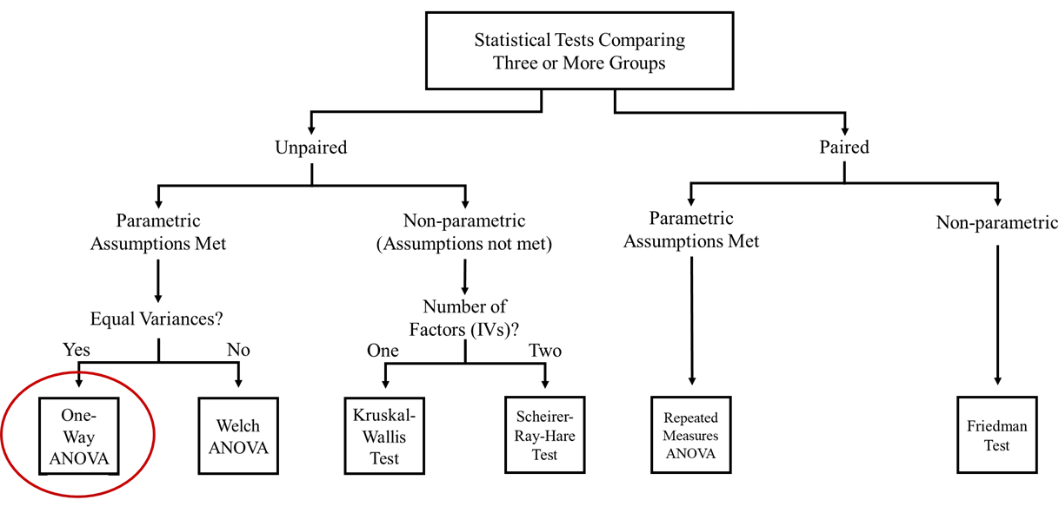
Statistical Tests Comparing Three or More Groups

Slide 8
What is a One-Way ANOVA?
We want the variability in our scores that can be explained by our independent variable (or our between-subjects variability) to be greater than the variability in our scores due to factors we cannot explain (error)
This is called within-group variability
ANOVAs test an omnibus effect
Tells us there is some difference between our groups, not which groups are specifically different from each other
We run post-hoc analyses to determine which groups specifically are different from one another
Test all possible group comparisons

Slide 9
When Do Researchers Use One-Way ANOVAS?
Determining whether there are differences between three or more independent groups
01
Measuring the same dependent variable across three or more independent (unrelated) groups
E.g., generation cohorts
Determining whether there are differences between conditions
02
Manipulating the independent variable by implementing different intervention/control groups with the same dependent variable being measured at some point in the study

Slide 10
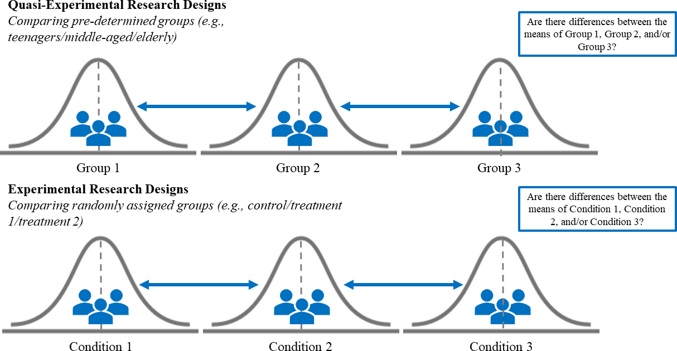
Comparing Three or More Groups

Slide 11
Hypotheses
NULL HYPOTHESIS:
Conceptual H_{0:} There are no significant group mean differences on DEPENDENT VARIABLE between Group 1, Group 2, Group 3 . . . Group_{k}
Mathematical H_{0:} There are no significant differences between the population means for Group 1, Group 2, Group 3 . . . Group_{k} on the dependent variable; M₁ = M₂ = M₃ . . . = M_{k}
ALTERNATIVE HYPOTHESIS:
Conceptual H_{1:} There is at least one significant group mean difference on DEPENDENT VARIABLE between Group 1, Group 2, Group 3 . . . Group_{k}
Mathematical H₁: There is at least one significant difference in the population group means on the dependent variable

Slide 12
Assumptions
Categorical independent variable
Continuous dependent variable
Independent observations
Normal distribution
No outliers
Homogeneity of variance
Assumptions 1-3 relate to the research design of the study and are required for a one-way ANOVA to by the appropriate statistical test
Assumptions 4-6 refer to those which data must meet in order to run the statistical test

Slide 13
Assumption 1: Categorical Independent Variable
We will use one-way ANOVAs to compare three or more categorical, independent groups
Categorical: participants are either in one level of the dependent variable or another
E.g., level of education (four groups: high school, some college, bachelor’s degree, master’s degree)
Independent: scores in each group are unrelated to each other

Slide 14
Assumption 2: Continuous Dependent Variable
Our dependent variable must be continuous
It must be measured on an interval or ratio scale of measurement
Likert-type scales are typically viewed as interval scales
Ratio scales include measures such as “How many hours of sleep did you get last night?”
This statistical test compares the means between three or more groups of scores on the dependent variable, so therefore the dependent variable must be continuous to calculate these values

Slide 15
Assumption 3: There Are Independence of Observations
There is no relationship between the observations in each group or between the groups themselves
E.g., there must be different participants in each group with no participant being in more than one group
This assumption is assumed to be true if participants only appear in one group our level of the independent variable

Slide 16
Assumption 4: Normal Distribution
The one-way ANOVA is a parametric test, therefore the assumption of normality is necessary for statistical significance
This assumption is “robust” to violations
The Central Limit Theorem states that if our sample size is large enough, the statistical test can handle n0nnormal distributions
We will test this assumption by checking that skewness and kurtosis statistics are within the acceptable range of -2 and +2 for each of our groups

Slide 17
Assumption 5: No Outliers
There should be no significant outliers in the dependent variable for any of our independent groups of scores
We will determine whether we have outliers by examining boxplots of the dependent variable for each group
Due to the impact outliers can have on the results, we must choose whether to include any outliers in our analyses, run a nonparametric equivalent instead (in this case, a Kruskal-Wallis test), or remove them from analyses
It is generally best practice to run analyses with and without outliers to compare whether the results differ

Slide 18
Assumption 6: There Is Homogeneity of Variances
The assumption of homogeneity of variances states that the population variance for each group of your independent variable is the same
We will test for this assumption using Levene’s test for equality of variances
If we meet all other assumptions, but violate the homogeneity of variances assumptions, there is the option of referring to alternative test statistics for the omnibus test (Welch-Satterthwaite correction to the degrees of freedom
The alternative post hoc test used for data that violates this assumption is the Games-Howell post hoc test (Tukey post hoc test is used if the assumption is not violated)

Slide 19
Statistical Significance
Is our p value less than our alpha level?
Conventional alpha level in psychology is .05
If p<a, our results are significant and we reject the null hypothesis
This means there is a significant difference between our groups (but doesn’t tell us which groups are different from which)
If this condition is met, we run a post hoc test to determine which groups are specifically different from which
If p>a, our results are not significant and we FAIL to reject the null hypothesis
This means there is NOT a significant difference between our groups

Slide 20
Practical Significance
Are our observed effects practically meaningful?
We look at our effect size as a measure of the magnitude of an observed effect
There are two families of effect size: d and r
We saw a prominent member of the d family, Cohen’s d, which used to measure effect size in independent and paired samples t-tests
The d family looks at the magnitude of standardized mean group differences
The r family includes r², η², partial η², and ω²
The r family looks at the proportion of the variance explained in the outcome variable by the independent variable(s)
For this chapter, there are three effect size measures that are commonly reported: eta squared (η²), partial eta squared (η2p), and omega squared (ω²)

Slide 21
Practical Significance cont.
Each of the effect sizes used with ANOVAs indicate how much total variability in our scores on the dependent variable (i.e., of the 100% amount of possible variability) can be accounted for or explained by the independent variable
The effect size used depends on what is being compared:
Partial eta squared is best used when comparing the effect size between studies with similar experimental research designs
Eta squared and omega squared are best used when comparting the size of an effect within a study (we will focus on these)
Eta squared estimates the proportion of variance explained from the sample data, which may be less accurate
Omega squared estimates the proportion of variance explained based on estimates the true population effect size (considered the less biased and more conservative measure)

Slide 22
Practical Significance cont.
Effect Size | Strength
0.01 | Small
0.06 | Medium
0.14 | Large

Slide 23
JASP Walk-Through Example
Minority stress theory describes how experiences with stigma, prejudice, and discrimination connect to the physical and mental health of sexual minority people (Meyer, 2003). As societal attitudes toward sexual minorities (e.g., gay, lesbian, and bisexual people) continues to improve, this theory would suggest that physical and mental health outcomes for this population should also improve. As you can see from the following Pew Research Center (2019) graph, attitudes in favor of same-sex marriage, for example, have increased significantly since 2004. Additionally, the US Supreme Court banned employment discrimination based on gender identity or sexual orientation in 2020. Using minority stress theory, these improvements in social context (e.g., attitudes, legislation) would suggest that sexual minorities have improved physical and mental outcomes. Meyer and colleagues (2021) conducted a study to see if there is support for this. Specifically, they wanted to know if minority stress is reduced in younger generations of sexual minorities, compared to older generations of sexual minorities. They did this by comparing the outcomes of three different cohorts of sexual minorities: Equality Cohort, aged 18-25 years (n = 670), Visibility Cohort, aged 34-41 years (n = 372), and Pride Cohort, aged 52-59 years (n = 476).
Meyer and colleagues (2021) examined numerous variables, both categorical and continuous. For the purposes of this guide, we will be using these two continuous variables as our dependent variables:
Connection with the LGBT community
Life Satisfaction

Slide 24
Research Questions
Connection with LGBT
Are there differences in connection with the LGBT community across the different cohorts?
Life Satisfaction
Are there differences in life satisfaction between the different cohorts?

Slide 25
What do you think we will find when we analyze the data?
What are your hypotheses?

Slide 26
Hypotheses: Connection with LGBT
The null hypotheses are:
Conceptual H₀: There are no significant group mean differences on connection with the LGBT community between the younger, middle-aged, and older adult groups.
The alternative hypotheses are:
Conceptual H₁: There is at least one significant group mean difference on connection with the LGBT community between the younger, middle-aged, and older adult groups.
Mathematical H₀: There are no significant differences between the population means for the younger, middle-aged, and older adult groups on connection with the LGBT community; M_{younger} = M_{middle}= M_{older}
Mathematical H₁: There is at least one significant difference between the population means for the younger, middle-aged, and older adult groups on connection with the LGBT community; M_{younger} ≠ M_{middle} ≠ M_{older}.

Slide 27
Hypotheses: Life Satisfaction
The null hypotheses are:
Conceptual H₀: There are no significant group mean differences on life satisfaction between the younger, middle-aged, and older adult groups.
The alternative hypotheses are:
Conceptual H₁: There is at least one significant group mean difference on life satisfaction between the younger, middle-aged, and older adult groups.
Mathematical H₀: There are no significant differences between the population means for the younger, middle-aged, and older adult groups on life satisfaction; M_{younger} = M_{middle}= M_{older}.
Mathematical H₁: There is at least one significant difference between the population means for the younger, middle-aged, and older adult groups on life satisfaction; M_{younger} ≠ M_{middle} ≠ M_{older}.

Slide 28
Let’s Analyze the Data!
Notes:
This Photo by Unknown Author is licensed under CC BY-ND

Slide 29
Creative Commons License
Notes:
CC BY-NC-ND: This license allows reusers to copy and distribute the material in any medium or format in unadapted form only, for noncommercial purposes only, and only so long as attribution is given to the creator.

