Slide 1

Chapter ?: Introduction
Statistics in Psychology

Slide 2

Learning Objectives
Teach statistical thinking
Students will be able to state the null and alternative hypotheses for statistical tests.
Students will understand the appropriate use of statistical tests.
Students will know how to accurately write the results of a statistical test in APA format.
Focus on conceptual understanding
Students will know how to calculate the results of statistical tests utilizing a mixture of hand calculations and statistical software programs.
Students will know how to interpret the results of statistical tests.
Students will be able to translate the results of said statistical test into real world meaning.
Use technology to explore concepts and analyze data
Students will know how to test that the dataset meets the assumptions needed to run statistical tests.
Students will know how to run statistical tests in JASP.
Statistical Tests and related concepts
Students will be familiar with the following statistical tests:
Descriptive statistics: mean, standard deviations
NHST add-ons: effect size, confidence intervals
Z-scores and tests
T-tests: single, independent, and paired samples
ANOVA: one-way and two-factor
Correlation
Regression
Chi-square
Notes:
Teach statistical thinking
Students will be able to state the null and alternative hypotheses for statistical tests.
Students will understand the appropriate use of statistical tests.
Students will know how to accurately write the results of a statistical test in APA format.
Focus on conceptual understanding
Students will know how to calculate the results of statistical tests utilizing a mixture of hand calculations and statistical software programs.
Students will know how to interpret the results of statistical tests.
Students will be able to translate the results of said statistical test into real world meaning (i.e., how would you explain the results to someone not taking this course?).
Use technology to explore concepts and analyze data
Students will know how to test that the dataset meets the assumptions needed to run statistical tests.
Students will know how to run statistical tests in JASP.
Statistical Tests and related concepts
Students will be familiar with the following statistical tests:
Descriptive statistics: mean, standard deviations
NHST add-ons: effect size, confidence intervals
Z-scores and tests
T-tests: single, independent, and paired samples
ANOVA: one-way and two-factor
Correlation
Regression
Chi-square

Slide 3

Welcome!
This course takes an applied approach to teaching statistics
  Inferential Statistics (i.e., t tests, ANOVA, correlation, regression, chi-square) will highlight different areas of diversity research
    Serves as a framing device for the learning and application of the different statistical concepts covered
Reasons for this approach:
  Provides real examples of research that demonstrate the application of the statistical concept highlighted
  Introduction to the way researchers discuss and present statistics in peer-reviewed journals
  Helps bridge the gap between statistics and research methodology

Slide 4
Connecting Statistics and
Research Methodology/Design
Examples come from real published data and demonstrate researchers using each statistical test covered in real life
Each example outlines:
Research question
Research design
Why chosen statistical test was most appropriate to answer the research question
Assignments use real data from human participants to practice statistical analyses

Slide 5
Why should psychological science care about diversity?
Diversity is a major area of psychological research itself, but also affects the work done in almost every sub-discipline of psychology
The APA’s Ethical Principles of Psychologists and Code of Conduct calls on us to be knowledgeable about diversity in order to avoid biases and prejudices– not an easy task
The research examples in the manual illustrate our course concepts AND help us understand diversity

Slide 6

Why should psychological science care about diversity?
“It’s about good science.” (Sellers, 2015)
Scientists are trained to work objectively but they are still human
  Complete objectivity when examining and trying to explain human behavior may not be possible
Notes:
We all have biases. It’s just a fact of life. These biases influence how we interact with people of different multicultural statuses (e.g. different genders, different age, different racial/ethnic background, different sexual identity, etc.). If we do not know and attempt to control our biases, then it can lead to things like discrimination, intolerance, and racism. While researchers love to think that they are “above” such biase...it’s simply not true. Researchers have biases like anyone else. These biases affect what research questions we ask, how we attempt to answer these questions, how we analyze the data we collect, and how we interpret results.
Slide created by Created by Zachary J. Kunicki, PhD as part of their “Social Justice in Statistics” presentation.

Slide 7

Notes:
YouTube Video Link: https://youtu.be/Ho6OlPrD7sA
In a 2010 review of Behavior and Brain Sciences, 95% of studies used college students (Henrich, Heine & Norenzayan, 2010).
College students tend to be WEIRD:
White, Educated, Industrialized, Rich, and Democratic
WEIRD samples exclude variability provided from other perspectives.

Slide 8
In a 2010 review of Behavior and Brain Sciences, 95% of studies used college students (Henrich, Heine & Norenzayan, 2010).
Did you know?

Slide 9
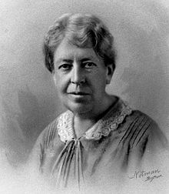
What else has biased our understanding of psychology?
Lack of early representation and opportunities for women and people of Color
  Inability to obtain degrees (Mary Whiton Calkins, 1st woman APA president, never granted degree by Harvard)
  Barred from scientific circles and organizations (e.g., Titchener barred women from Experimentalists, a group formed in 1904)
Men took credit for women’s work (i.e., Matilda Effect)
  Georg Müller “reinvented“ Mary Whiton Calkins‘ groundbreaking paired-associations method
Impacted what research questions were asked and how they were interpreted for centuries
Notes:
http://faculty.webster.edu/woolflm/calkins.html

Slide 10
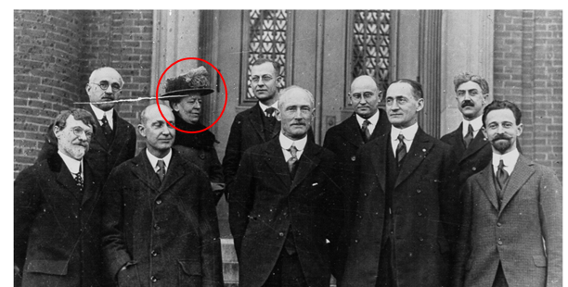
Notes:
Mary Whiton Calkins pictured with other prominent psychologists at Harvard on December 29th, 1919.
Back row: Dodge, Calkins, Ogden, Hollingsworth, Baldwin
Front row: Warren, Woodworth, Seashore, Scott, and Langfeld

Slide 11
ADDRESSING Model of Diversity
(Hays, 1996, 2008)
Age & Generation
Developmental Disability
Disability (Acquired)
Religion
Ethnicity & Race
Socioeconomic status
Sexual orientation
Indigenous Group
National Origin & Language
Gender
Notes:
Aim of model: “facilitate recognition and understanding of the complexities of individual identity and contribute to a complete understanding of cultural identity”
We are all a mixture of these identities, which can shape and explain our experiences in the world
Lab manual uses this model as a guidepost for incorporating diversity topics into the teaching of statistics and research design

Slide 12
The “Backfire Effect”
“The Backfire Effect” is the tendency for people to increase their original stance or perspective about something, even in the face of evidence that contradicts their original stance or perspective
You may encounter topics that you haven’t heard of before, or that may conflict with your personally held beliefs and attitudes
As a result, you may find yourself wanting to reject the research and statistics we cover in order to protect your original beliefs and attitudes– keep in mind:
  We are not trying to change your mind or persuade you about these topics. You are entitled to your beliefs, attitudes, and worldviews. We are simply trying to highlight research on diversity topics in order to increase awareness of these issues and highlight often underrepresented identities in psychological research and science.
  If you experience a conflict between your personal views and the topics covered, not only is that okay, but it is also normal and expected.
The goal of this course is to encourage you to keep an open mind, and ultimately not to reject the information you encounter, but to reflect and contemplate on how you can incorporate this information into your existing worldview and perspective
This creates not only a space conducive for exploring and discussing multiple worldviews, but also makes for better science!

Slide 13
What are Statistics?
Statistics are a branch of mathematics that deal with “the collection, analysis, interpretation, and presentation of masses of numerical data” (Merriam-Webster, n.d.)
We will cover two branches of statistics in this course:
  Descriptive statistics: summarize (describe) the data
  Inferential statistics: generalizes (makes inferences) about the general population based on a sample

Slide 14
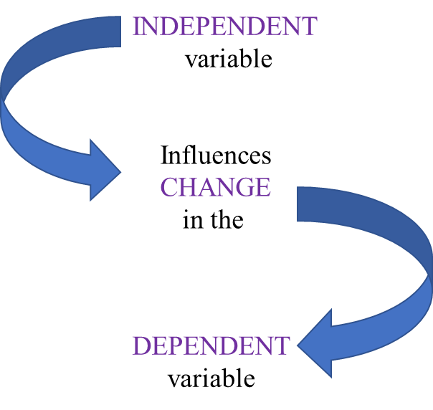
Descriptive Statistics
Summarize/describe data
What gets summarized? Variables!
Variables: different items that we collect data about
  Demographic variables: capture information about a participant, cannot be manipulated
  Independent variables: things in a research study that are manipulated by the researchers
  Dependent variable: value of this variable depends on the manipulation
Notes:
Examples of demographic variables: age, ethnicity, highest level of education
Example of study to demonstrate relationship between IV and DV: does an intervention change participants’ perceptions of older adults compared to those who did not receive intervention?
IV: condition (intervention/control)
DV: measure of perception of older adults

Slide 15
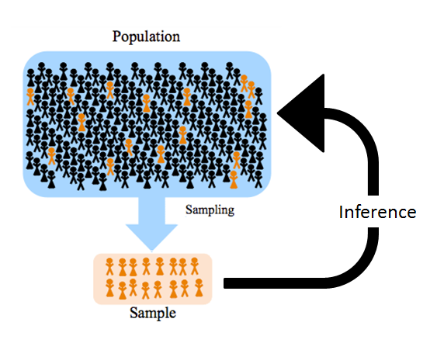
Inferential Statistics
Generalize to the population based on the sample of participants in a study
Sample: a portion of the whole population
  The closer a sample reflects the characteristics of a population, the more confidence we have in our statistics being able to generalize to the population
Population: all the people in a particular domain
Notes:
Example for sample vs population: selection of students at a university vs ALL students at that university

Slide 16

Null Hypothesis Significance Testing
Hypothesis: a testable statement of what the researchers predict will happen in a study based on prior knowledge and/or observation
  Does not claim to be explicitly true or false: allows for scientific exploration into the validity of the statement
Null hypothesis: possibility that the hypothesis is false, where we propose that there is no relationship between the variables of interest in our study
Null hypothesis significance testing (NHST): compares probability of our data either supporting the hypothesis (there is a relationship between the variables of interest) or rejecting our hypothesis in favor of the null hypothesis (there is no relationship between the variables of interest)

Slide 17
Other Hypothesis Testing Terminology
Alpha level: threshold value used to judge whether a test statistic is statistically significant
P values: the probability of obtaining your results if the null hypothesis is TRUE
Test statistics: used to calculate the probability that our observed results either support or reject the null hypothesis (e.g., t-statistics, Z-statistics, F-statistics)

Slide 18
The Importance of Research Design in Statistics
Does the research question merit a qualitative or a quantitative design?
  Qualitative: takes an inductive approach, focuses on exploration and description of a topic
  Quantitative: takes a deductive approach, focuses on testing hypotheses
    3 types of quantitative research design:
      Experimental
      Quasi-Experimental
      Correlational

Slide 19
Experimental and Quasi-Experimental Research Design
How are the groups in the study formed?
  Experimental: participants are randomly assigned to a group
  Quasi-Experimental: participants are grouped based on a characteristic or attribute they already possess
Quasi-experimental research designs allow researchers to compare groups that cannot be randomly assigned for practical or ethical reasons
True experiments in psychology must have random assignment and a control group
  Random assignment means participants have an equal chance of being assigned to any of the groups
  A control group is the group in the study that does not receive the experimental manipulation
Notes:
For example, a research may be interested in age differences in attitudes toward volunteering. Researchers cannot randomly assign participants to be young, middle-aged, or old, so they group participants based on their established chronological ages.

Slide 20
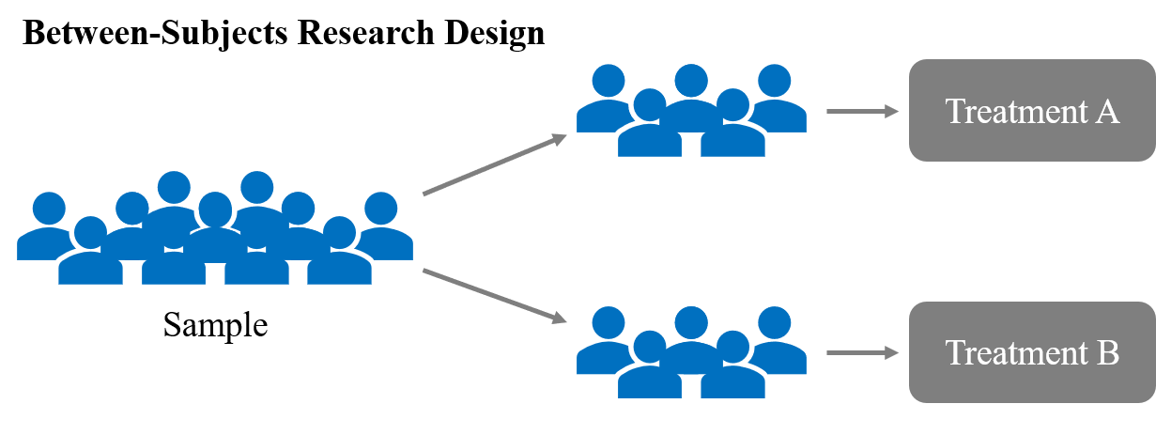
Between-Subjects Research Designs
Each participant is only exposed to one experimental condition
Statistical analyses then compare participants in different conditions on the dependent variable to see if there are any differences

Slide 21
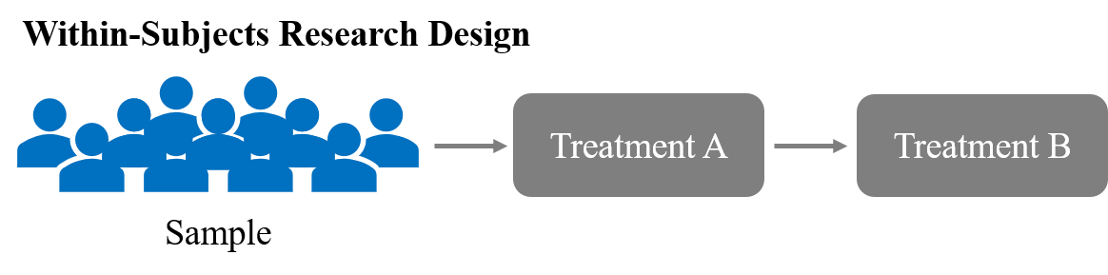
Within-Subjects Research Designs
Each participant is exposed to all conditions
Statistical analyses then compare the same group of participants on the dependent variable across the different conditions or timepoints to see if there are any differences

Slide 22
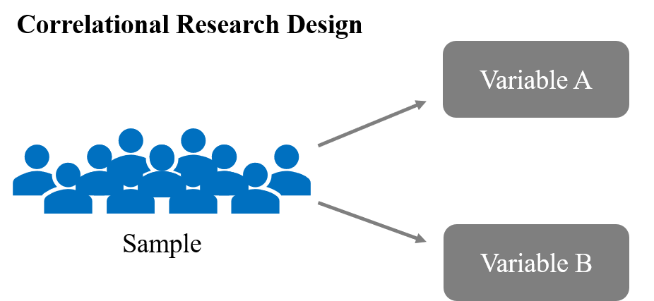
Correlational Research Designs
Determine relationships between variables that are measured without any manipulation by the researcher
Can’t infer a cause-and-effect relationship but can describe the relationship between variables
Can be used in situations where manipulation of variables of interest is impossible or unethical

Slide 23
Introducing Statistical Software
JASP: Open source, statistical analyses software program, based in Excel, graphic user interface
Excel: Spreadsheet software, allows for basic computations, data analysis, and data visualization
SPSS: Paid program, graphic user interface, option to code analyses
R: Open source, computer language and environment for statistical programming, download packages to perform statistical analyses/visualize data, requires some knowledge of coding

Slide 24
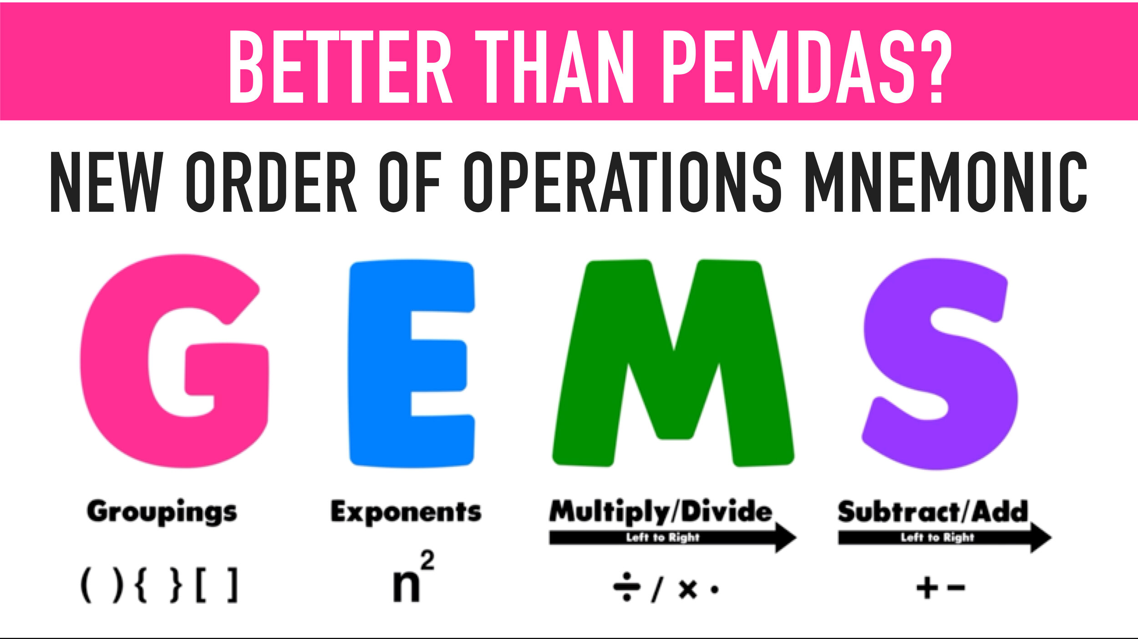

Math Basics
Operator notation
  Addition (+), subtraction (-), multiplication (*), division ($\frac{2}{4}$), exponents ($X^{n}$ OR X^n)
Order of operations (P.E.M.D.A.S.)
  parentheses, exponents, multiplication, division, addition, subtraction)
Averages
  $\frac{Sum of values}{Number of values}$
Exponents
  How many times we multiply the base by itself ($9^{3}$ = 9*9*9 = 729)
Solving for X
  Isolate a variable
  Use inverse operation to remove a term from one side of an equation
  What you do to one side of the equation, you must do to the other

Slide 25
Basic Excel Functions
Key Basic Excel Functions
=SUM() | Adds up all selected values
=COUNT() | Counts number of items selected
=AVERAGE() | Gives statistical average (sum/count)
=MAX() | Gives maximum (highest) value
=MIN() | Gives minimum (lowest) values
Anatomy of the Excel environment (rows, columns, cells)
  To enter information manually, click on an empty cell and type in the information
  To specify data we want a function to work with:
    Enter all values between parentheses separated by a comma
    OR select an array of data for function to be performed on

Slide 26

Notes:
CC BY-NC-ND: This license allows reusers to copy and distribute the material in any medium or format in unadapted form only, for noncommercial purposes only, and only so long as attribution is given to the creator.

