Slide 1
Chi-Square Tests
Chapter ?

Slide 2
Learning Objectives
Teach statistical thinking
Students will be able to state the null and alternative hypotheses for chi-square tests.
Students will understand the appropriate use of chi-square tests.
Students will know how to accurately write the results of chi-square tests in APA format.
Focus on conceptual understanding
Students will know how to interpret the results of chi-square tests.
Students will be able to translate the results of chi-square tests into real world meaning (i.e., how would you explain the results to someone not in this course?).
Use technology to explore concepts and analyze data
Students will know how to test that the dataset meets the assumptions needed to run chi-square tests.
Students will know how to run chi-square tests in JASP.

Slide 3
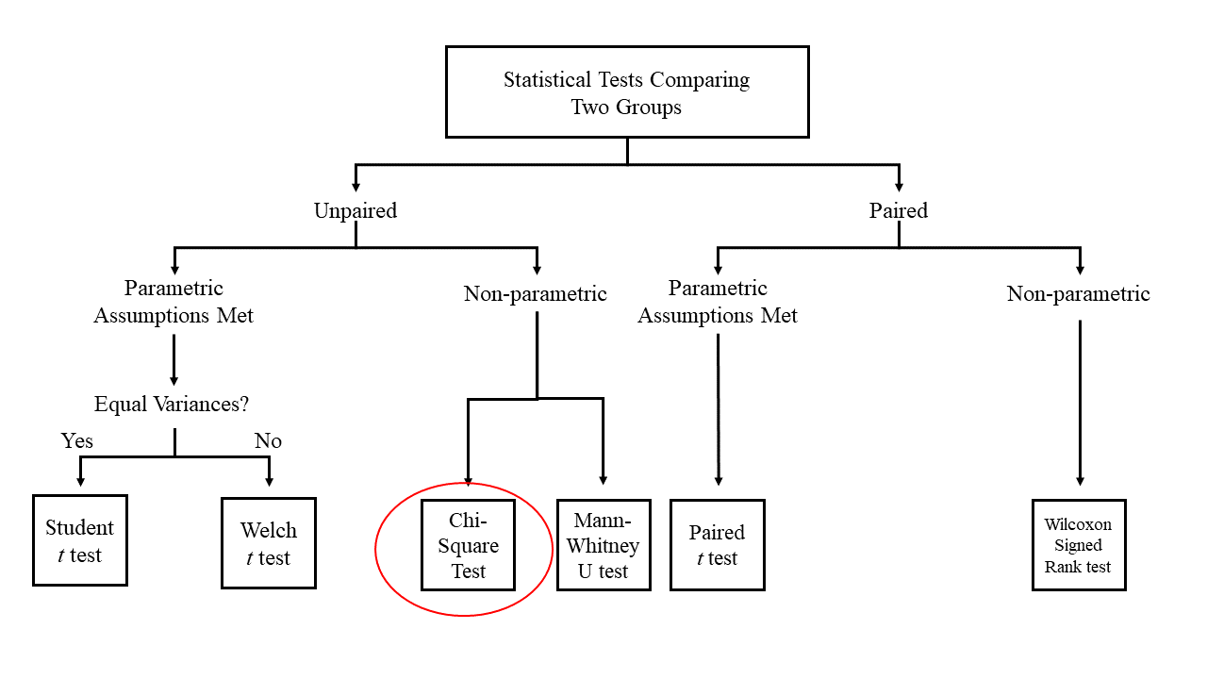
What is a Chi-Square Test?
The chi-square test for association examines whether two categorical variables are associated or related to one another.
More specifically, it tests for the association/independence between two categorical variables.
Chi-square tests look at an association between two dichotomous variables.
Remember that dichotomous variables are nominal variables with two possible values.

Slide 4
Research Example: Thompson, et al. (2011)
Research question: what is the relationship between sexual activity and age for postmenopausal women between the ages of 60-89?

Slide 5
Research Example: Thompson, et al. (2011)
Background:
When you think about the concept of “successful aging,” what comes to mind? Common answers might be maintaining physical health, healthy cognitive function, and psychological and emotional well-being.
Other aspects include sexual activity & function – yes! Older adults also continue to have healthy sex lives
Research suggests that healthy sexual activity may be especially beneficial for postmenopausal women (Lindau & Gavrilova, 2010).
Researchers have found that for older women, being more satisfied with one’s sex life is related to several positive outcomes:
Greater relationship satisfaction (Hawton et al., 1994)
Better mental health (Addis et al., 2006)
General well-being (Davison et al., 2009)

Slide 6
Research Example: Thompson, et al. (2011)
Research question:
What is the relationship between sexual activity and age for postmenopausal women?
Variables:
Sexual activity → “Has sex been a part of your life in the last six months, with or without a partner?”
Answers will be dichotomous → yes or no
Age → rather than looking at this as a continuous variable, researchers broke the age range into three categories:
Age 60-69
Age 70-79
Age 80-89
**This is an example of a multinomial categorical variable**

Slide 7
Research Example: Thompson, et al. (2011)
Sexual Activity | Age
 | Age 60-69 | Age 70-79 | Age 80-89
Yes | 201 | 184 | 38
No | 153 | 286 | 174

Slide 8
Research Example: Thompson, et al. (2011)
Statistical Findings:
There was a statistically significant difference between the different age groups and sexual activity, X²(2) = 83.90, p < 0.001
Practical significance:
As women age they become less sexually active, with this difference being greatest for the 80-89 age category, followed by the 70-79 age category, and finally the 60-69 age category.

Slide 9
Let’s think about it…
Why did the researchers use a chi-square test to answer their research questions?
What do their results mean?
How would you improve this study?
Notes:
The researchers were looking for a difference between age groups in terms of a categorical (in this case, multinomial) dependent variable.
As women age, they become less sexually active, with this difference being greatest for the 80-89 age category, followed by the 70-79 age category, and finally the 60-69 age category. In fact, the oldest age group of women was also less likely to report sexual desire and sexual arousal compared to young old women. However, it’s important to note that there was no difference in sexual satisfaction between the different age groups. Meaning, all age groups were equally satisfied sexually. In other words, activity is not the same thing as satisfaction. Further, reporting less levels of arousal/etc. doesn’t mean that oldest old women didn’t report that they never experienced it – that age group was just less likely compared to younger age groups. Some of the lack of arousal may also be due to a lack of a partner. The older a woman is, the more likely they have lost their romantic partner.
3. Thompson et al. (2011) describe a few limitations of their study. First, they used a cross-sectional method so any assumed aging differences cannot necessarily be separated from cohort effects (i.e., differences between groups OTHER than age. Future research might consider a longitudinal design instead. Second, the WHI San Diego cohort was predominately White and educated and may not generalize to other non-White individuals of different socioeconomic factors. Finally, there was a low response rate, calling into question whether there was a response bias for data interpretation (e.g., is there something unique about people who elected to participate compared to those who chose not to?). Future research might explore other ways to obtain data from a broader sample of women.

Slide 10
What do Chi-square tests do?
Assesses a contingency table
A frequency table that has two categorical variables with rows and columns corresponding to the categories for the variable
The Chi-square test compares the observed frequencies from the contingency table against would expect if there was no association between the two variables.
These expected values are called expected frequencies
The greater the association between the two variables, the greater the observed and expected frequencies will differ
The weaker the association between the two variables, the closer the observed and expected frequencies will be

Slide 11
What do Chi-square tests do?
Let’s consider a contingency table for two different dichotomous variables:
Depression Status
Whether someone has depression or doesn’t have depression
Relationship Status
Whether someone is single or in a committed relationship
Our data will be the frequency of participants for each of the four possible combinations of responses
Relationship Status | Depression Status
 | Has Depression | Doesn’t have Depression
Single | # of single people who are depressed | # of single people who are not depressed
Committed Relationship | # of people in committed relationships who are depressed | # of people in committed relationships who are not depressed
These values are the observed frequencies

Slide 12
Let’s see the math!
Remember: these are the observed frequencies!
Let’s assume that the total sample size was n=100…
Relationship Status | Depression Status |  | Totals
 | Has Depression | Doen’t have depression
Single | 32 | 19 | Total “Single” (32+19) = 51
Committed Relationship | 25 | 24 | Total “Committed Relationship” (25+24) = 49
Totals | Total “Has Depression” (32+25) = 57 | Total “Doesn’t have depression” (19+24) = 43 | Overall Total 100

Slide 13
Let’s see the math!
To calculate the expected frequencies, we use the following formula:
E_{ij} = (row total_{i} * column total_{j})/n
Where…
E_{ij} = the expected frequency for a given cell
n = total number of observations
i = variable represented in rows
j = variable represented in columns
Based on this formula, we can now calculate the expected frequencies from our example

Slide 14
Let’s see the math!
Formula: E_{ij} = (row total_{i} * column total_{j})/n
Relationship Status | Depression Status |  | Totals
 | Has Depression | Doesn’t have depression
Single | (51*57)/100 = 29.07 | (51*43)/100 = 21.93 | Total “Single” (32+19) = 51
Committed Relationship | (49*57)/100 = 27.93 | (49*43)/100 = 21.07 | Total “Committed Relationship” (25+24) = 49
Totals | Total “Has Depression” (32+25) = 57 | Total “Doesn’t have depression” (19+24) = 43 | Overall Total 100
Let’s assume that the total sample size was n=100…

Slide 15
Let’s see the math!
Relationship Status | Depression Status
 | Has Depression | Doesn’t have depression
Single | Observed: 32 Expected: 29.07 | Observed: 19 Expected: 21.93
Committed Relationship | Observed: 25 Expected: 27.93 | Observed: 24 Expected: 21.07
Is the observed value of 32 different enough from the expected value of 29.07 to suggest an association between our two variables?
That is what the chi-square test will tell us!
Thankfully – JASP can do all of the math for us!

Slide 16
What do Chi-square tests do?
“Wait! Are we looking at group differences or relationships with this test?”
YES!
Mathematically we are looking to see if the two variables are associated.
However, these are meaningful groups that we are interested in comparing.
The answer will depend on the research question.

Slide 17
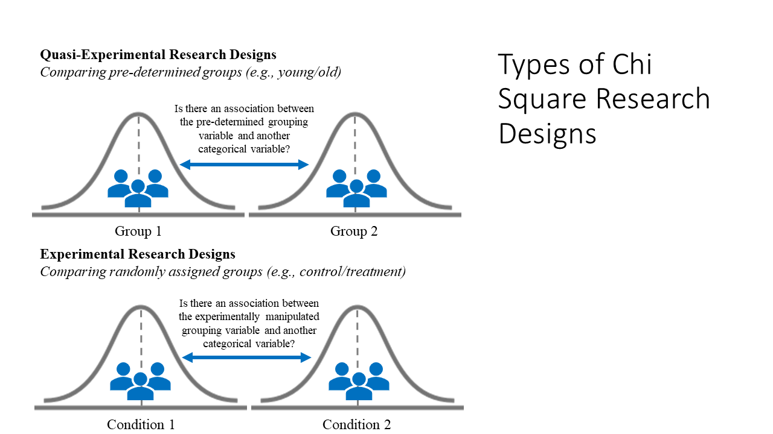
When do researchers use a Chi-square test?
Quasi-experimental designs
Is there an association between the predetermined grouping variable and the other categorical variable?
Experimental designs
Is there an association between the experimentally manipulated grouping variable and the other categorical variable?

Slide 18
Hypotheses
The null hypothesis is:
Conceptual H₀: There is no significant association between VARIABLE X and VARIABLE Y.
Mathematical H₀: The observed frequencies are equal to the expected frequencies.
The alternative hypothesis is:
Conceptual H₁: There is a significant association between VARIABLE X and VARIABLE Y.
Mathematical H₁: The observed frequencies are not equal to the expected frequencies.

Slide 19
Assumptions
1. Two Categorical Variables
2. Independent Observations
3. Expected Counts Greater than Five

Slide 20
Assumption 1: Two Categorical Variables
There must be two categorical variables
Nominal variables
Dichotomous examples→ right or left handed; single or in a committed relationship
Multinomial examples→ health professions: surgeon, nurse, dentist, doctor
Ordinal variables
E.g., socioeconomic status: lower class, middle class, and upper class
A chi-square test will ignore order and look at group differences

Slide 21
Assumption 2: Independent Observations
Participants in all groups/cells are different
A
B
C
D
E
F
G
H
I
J
K
L
Condition A
Condition B
Condition C
From our example:
No one is both depressed as well as not depressed; no one is single as well as being in a committed relationship.

Slide 22
Assumption 3: Expected Counts Greater than 5
The expected counts (or, the expected frequencies) for EACH CELL must be greater than 5
If this assumption is violated, you must conduct a Fisher’s Exact Test
This corrects for the low expected frequency in the contingency table
5
Expected frequencies

Slide 23
Statistical Significance
As with some of the other tests that we have covered thus far (e.g. independent samples t-test), you will be assessing significance using a p-value.
This value is set by the alpha level (Type 1 Error)
Traditionally, we use a p-value of 0.05 to determine significance
Values greater than 0.05 are non-significant
Values less than 0.05 are significant

Slide 24
Practical Significance
The chi-square test will only tell us whether the variables are associated or not
To determine the strength of the association, we will look either at Phi (ϕ) or Cramer’s V, and an odds ratio

Slide 25
Practical Significance: When & How to use Phi
When?
Only when you have two dichotomous variables
How?
Values will be between -1 and +1
Values close to zero indicate that there is no relationship between the variables
Values close to ± 1 indicate a strong relationship
Close to -1 indicates a strong negative relationship
Close to +1 indicates a strong positive relationship

Slide 26
Practical Significance: When & How to use Cramer’s V
When?
When one or both variables are multinomial
E.g., Health professions: surgeon, doctor, nurse, dentist
How?
The guidelines for the strength of association must take into account how many cells exist in the contingency table.

Slide 27
How to use Cramer’s V
The table provides the guidelines for small, medium, and large effect sizes for Cramer’s V.
These values are determined by the degrees of freedom for the chi-square test, which is equal to (R-1)(C-1) where R = the number of groups/levels for the variable in the row of the contingency table, and C= the number of groups/levels for the variable in the column of the contingency table.
 | Small Effect Size | Medium Effect Size | Large Effect Size
df_{RC}=1 | .10 | .30 | .50
df_{RC}=2 | .07 | .21 | .35
df_{RC}=3 | .06 | .17 | .29
df_{RC}=4 | .05 | .15 | .25
df_{RC}=5 | .05 | .13 | .22

Slide 28
Practical Significance …and the Odds Ratio
The other piece of information to consider is something called the odds ratio.
An odds ratio tells us a little bit more about the way in which our two variables are related to one another. Generally, the odds ratio compares the odds between the group we’re interested in and the comparison group. To get the odds ratio, we need to follow this general formula:
OR = (a / b) / (c / d) which reduces to (a * d) / (b * c)
Where:
OR = odds ratio
a = participants in the group we’re interested in where the outcome is present
b = participants in the group we’re interested in where the outcome is not present
c = participants in the group we’re comparing to where the outcome is present
d = participants in the group we’re comparing to where the outcome is not present
Let’s put this in the context of our example where we calculated the expected frequencies to make it a little more tangible.

Slide 29
Let’s see the math!
Formula:
OR = (a*d)/(b*c)
Relationship Status | Depression Status
 | Has Depression | Doesn’t have depression
Single | Observed: 32 Expected: 29.07 | Observed: 19 Expected: 21.93
Committed Relationship | Observed: 25 Expected: 27.93 | Observed: 24 Expected: 21.07
If we plug these values into the formula we get the following calculation:
OR = (32 * 24) / (19 * 25)
OR = 768 / 475 = 1.62
What this value is telling us is that the odds of single people having depression are 1.62 times greater than they are for people in committed relationships.
a
b
c
d

Slide 30
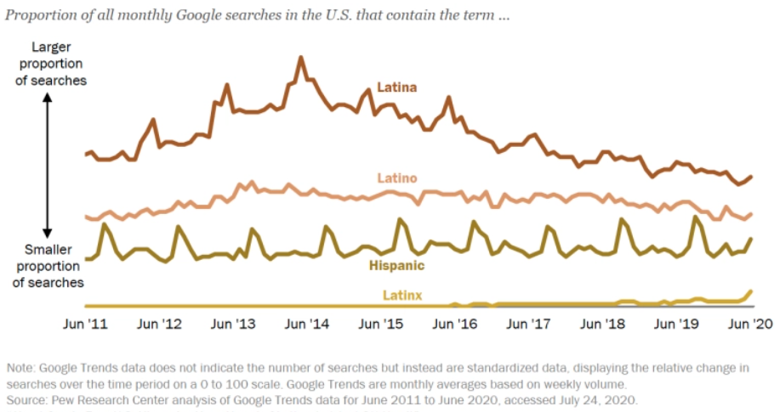
Walk-Through Example
Background:
The terms used to describe their ethnic identity by people who can trace their origins back to South America, Latin America, and Spain varies between individuals and have changed over time. In a national survey of 5,103 Hispanic adults in 2013, the Pew Research Center found that the majority of participants defined their ethnic identity in terms of their specific Hispanic origin, particularly those who immigrated to the U.S. from other countries. For example, using terms that indicated a geographical origin such as Dominican, Cuban, South American, Puerto Rican, or Salvadoran. The rest of the participants used the terms Hispanic, Latino, or American, with higher proportions of native-born participants using these terms – particularly amongst third generation members of the Hispanic community. Recently, a gender-neutral term, Latinx, has been gaining momentum as a new way of describing the Hispanic population in the U.S. Why use the term Latinx instead of Latino, Latina, or Hispanic? As one younger participant in a national survey explained, “Latinx is a more inclusive term to use for those who do not choose to identify with a certain gender. The terms Latino and Latina are very limiting for certain people” (Noe-Bustamante, Mora, & Hugo Lopez, 2020).
Although Google trend data between 2011-2020 shows a rise in the prevalence of Latinx, the terms Latina, Latino, and Hispanic continue to be more widely used.
Pew Research Center Graph (2020)

Slide 31
Walk-Through Example
Background Continued:
A recent survey by researchers at the Pew Research Center found that 76% of U.S. Hispanic/Latino adults surveyed in late 2019 had not heard of the term Latinx (Noe-Bustamante et al., 2020); however, of the 23% who had heard of the term, only 3% reported using it to describe themselves. Additionally, younger participants between 18-29 years old were the most likely to have heard of the term Latinx, with 42% saying they were familiar with the term compared to only 7% of older adults 65 years and older. When asked if they thought Latinx should be adopted as a pan-ethic term for U.S. Hispanics, the majority of participants (61%) said they prefer the term Hispanic, 29% preferred Latino, and only 4% said they preferred Latinx.

Slide 32
Research Question
Knowing there are age differences in terms of how aware participants are of the term Latinx, are there also age differences in whether participants think the term Latinx should be adopted by the Hispanic/Latino population?
For this walk-through example, we are going to focus on two of these variables: “Age” and “Latinx.”
We want to see whether there is an association between age groups (18-29, 30-49, 50-64, and 65+) and whether a person thinks Latinx should be used to describe the Hispanic or Latino population (Yes, No).

Slide 33
What do you think we will find when we analyze the data?
What are your hypotheses?

Slide 34
Researcher Hypotheses
The null hypotheses are:
Conceptual H₀: There is no significant association between age groups and whether a person thinks Latinx should be used to describe the Hispanic or Latino population.
The alternative hypotheses are:
Conceptual H₁: There is a significant association between age groups and whether a person thinks Latinx should be used to describe the Hispanic or Latino population
Mathematical H₀: The observed frequencies are equal to the expected frequencies.
Mathematical H₁: The observed frequencies are not equal to the expected frequencies.

Slide 35
Let’s Analyze the Data!
Notes:
This Photo by Unknown Author is licensed under CC BY-ND

Slide 36
Creative Commons License
Notes:
CC BY-NC-ND: This license allows reusers to copy and distribute the material in any medium or format in unadapted form only, for noncommercial purposes only, and only so long as attribution is given to the creator.

