Slide 1
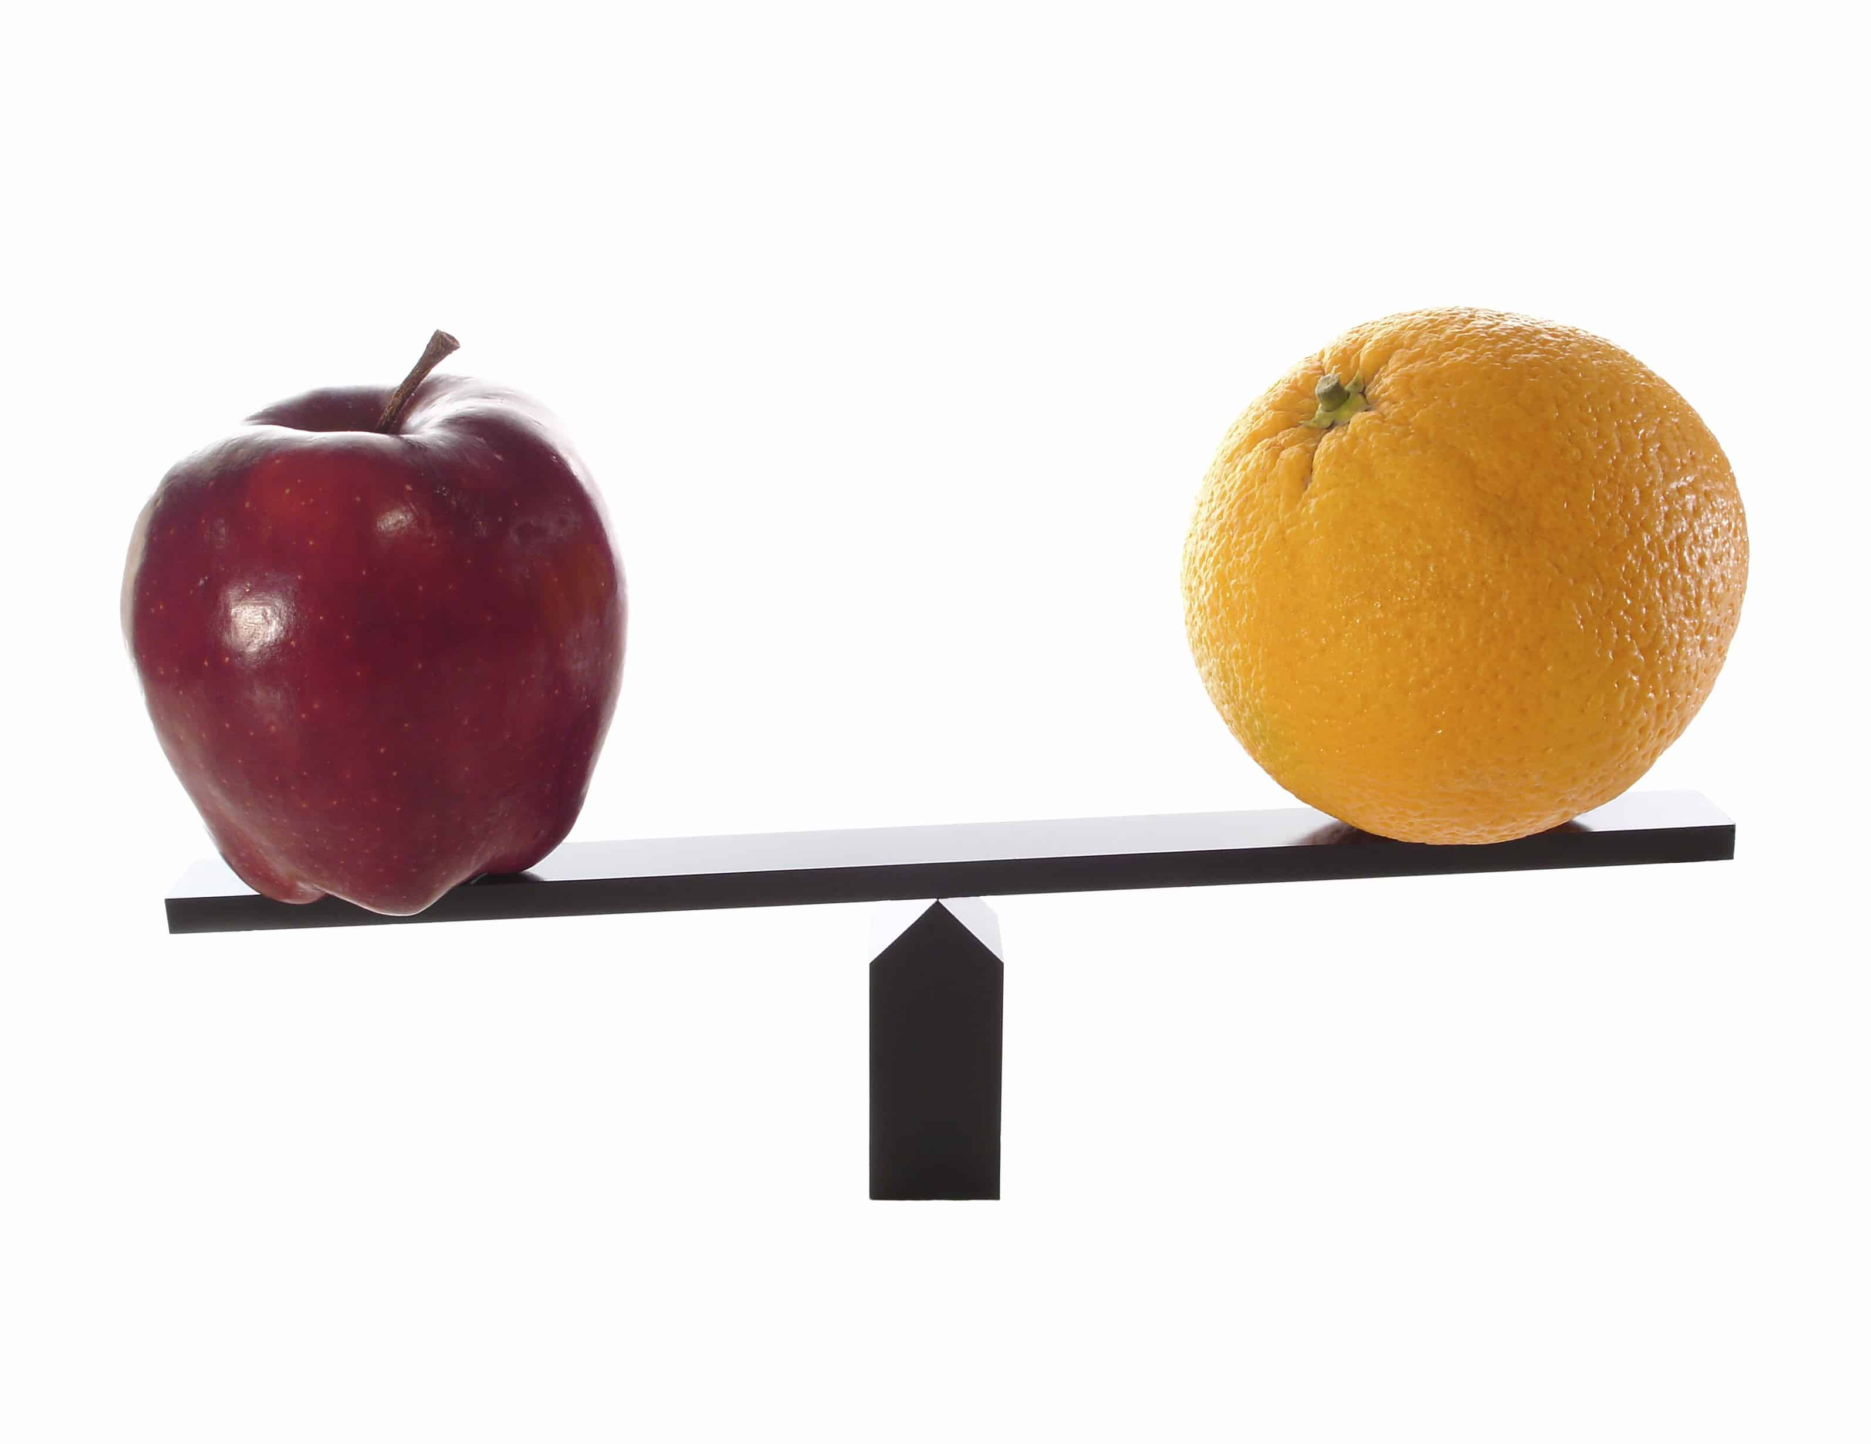
Chapter ?
Independent Samples t Tests

Slide 2

Learning Objectives
Teach statistical thinking
  Students will be able to state the null and alternative hypotheses for independent samples t-tests.
  Students will understand the appropriate use of independent samples t-tests.
  Students will know how to accurately write the results of independent samples t-tests in APA format.
Focus on conceptual understanding
  Students will know how to interpret the results of independent samples t-tests.
Students will be able to translate the results of independent samples t-tests into real world meaning (i.e., how would you explain the results to someone not taking this course?).
Use technology to explore concepts and analyze data
  Students will know how to test that the dataset meets the assumptions needed to run independent samples t-tests.
  Students will know how to run independent samples t-tests in JASP.

Slide 3
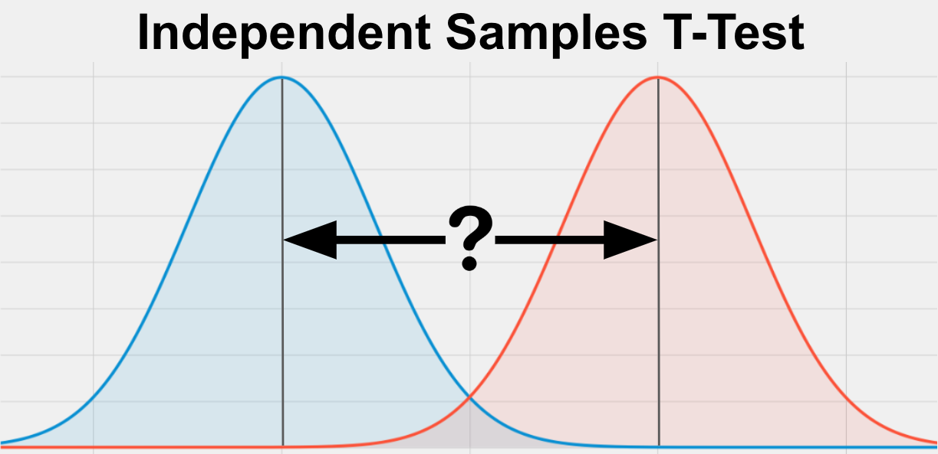
What is an independent samples t test?
A statistical test that compares the means of two separate, independent groups to see if they are different from one another

Slide 4
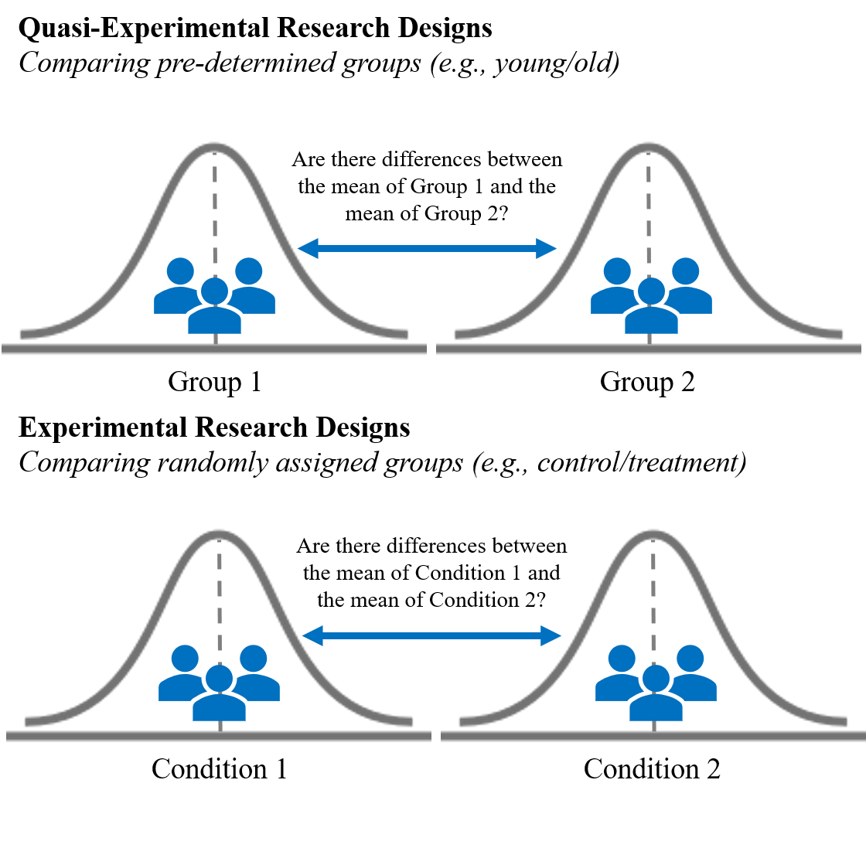
When do researchers use independent samples t tests?
To determine if there are statistical differences in the means of two independent groups of data

Slide 5

Example:
Sipe et al. (2009)
Research Questions: Are there differences in how much undergraduate business majors anticipate gender discrimination impacting: (1) their career and (2) the careers of other women?

Slide 6
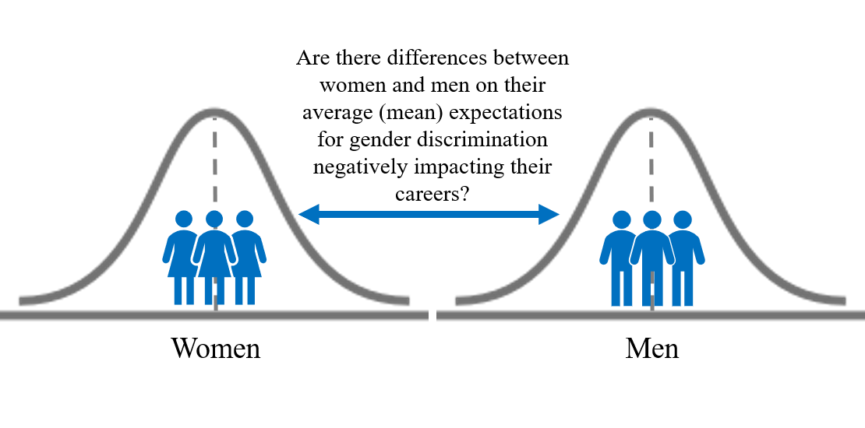
Sipe et al. (2009) Research Question 1

Slide 7
Sipe et al. (2009) Findings
Women were significantly more likely to expect gender discrimination to impact their careers
t(1,333) = -8.08, p < .001
Women were also more likely to expect gender discrimination to impact the careers of other women
t(1,332) = -5.60, p < .001

Slide 8
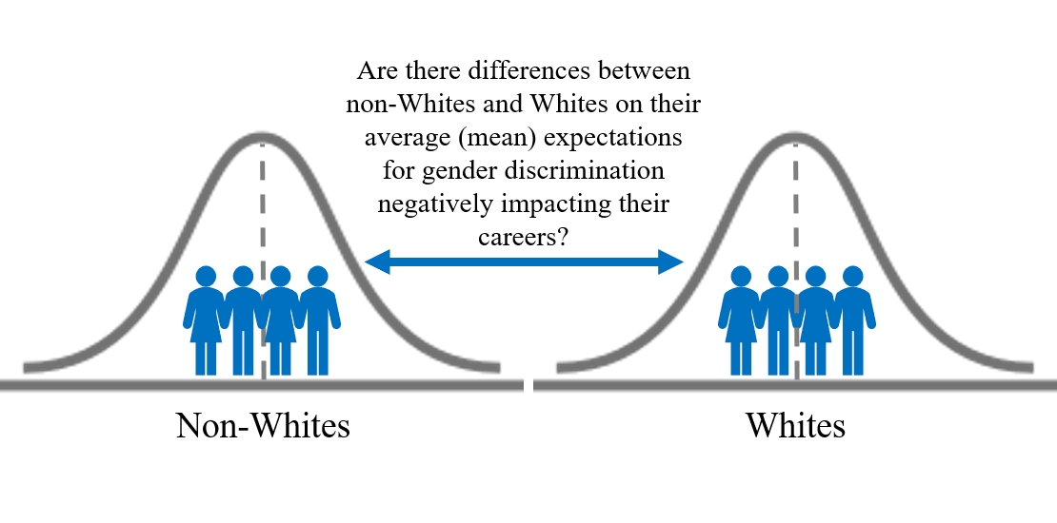
Sipe et al. (2009) Research Question 2

Slide 9
Sipe et al. (2009) Findings
Whites were significantly less likely to expect gender discrimination to impact their careers
t(1,338) = -2.64, p < .01
Whites were more likely to expect gender discrimination to impact the careers of other women
t(1,337) = 4.42, p < .001

Slide 10
Let’s think about it…
Why did the researchers use independent-samples t tests to answer their research questions?
What do their results mean?
How would you improve this study?
Notes:
1. The researchers were comparing the means of two separate groups on continuous dependent variables.
2. The authors suggested a couple overall conclusions. Overall, college students underestimate the potential for gender discrimination in the workplace. Although women were more likely to anticipate gender discrimination in the workplace, they were more likely to anticipate it for someone else rather than themselves. This may be concerning since research has shown high prevalence rates for gender-based discrimination in the workplace – meaning students may be underprepared for the future discrimination they may face. Additionally, although non-white participants were more likely to anticipate women would face gender discrimination in the workplace, they believed they would be less impacted personally. The authors were not sure why this may be and suggested it could be because non-white participants have already experienced discrimination in their lives and feel more equipped/desensitized to it than white students. However, more research is needed to better understand the race-related implications of this study.
3. It was conducted in 2006 (published in 2009), so there may be time of measurement concerns that mean data from 2006 is different from 2023. Replicating this study to see if students have the same perceptions following the #MeToo movement, Women’s Marches, and other awareness raising campaigns is needed. There are also sampling concerns. The authors used a convenience sample of undergraduate business majors that was not gender balanced (38.7% women, 58.6% men). Study was administered during class time. Race was dichotomized into white and non-white instead of allowing for an analysis by individual race/ethnic categories (likely due to sample size concerns). Would also be good to analyze the data by participant gender and race simultaneously to see if there is an interaction using a two-way ANOVA.

Slide 11
Hypotheses
The null hypothesis is:
  Conceptual H₀: There are no significant mean differences in DEPENDENT VARIABLE between SAMPLE 1 and SAMPLE 2.
  Mathematical H₀: The mean for GROUP 1 is equal to the mean for GROUP 2; M₁ = M₂
The alternative hypothesis is:
  Conceptual H₁: There are significant mean differences in DEPENDENT VARIABLE between GROUP 1 and GROUP 2.
  Mathematical H₁: The mean for GROUP 1 is not equal to the mean for GROUP 2; M₁ ≠ M₂

Slide 12
Assumptions
Categorical Independent Variable (IV)
Continuous Dependent Variable (DV)
Independent Observations
Normal Distribution
No Outliers
Homogeneity of variance

Slide 13

Categorical Independent Variable (IV)
IV must be:
  Dichotomous (have only two groups)
  Measured at the nominal level
    E.g., left dominant or right dominant

Slide 14

Continuous Dependent Variable (DV)
DV must be:
  Continuous
  Measured at the interval or ratio level
    E.g., height, weight, Beck Depression Inventory, Big Five personality inventory, etc.

Slide 15

Independent Observations
Participants in both groups are different
A
B
C
D
E
F
G
H
Condition A
Condition B

Slide 16
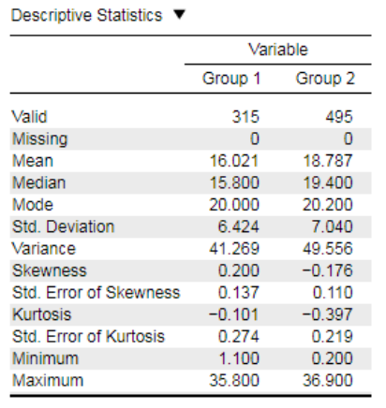
Normal Distribution
Dependent variable is normally distributed within each group
  Want Skewness and Kurtosis Statistics between -2 and +2
Notes:
https://static.jasp-stats.org/Statistical%20Analysis%20in%20JASP%20-%20A%20Students%20Guide%20v1.0.pdf

Slide 17
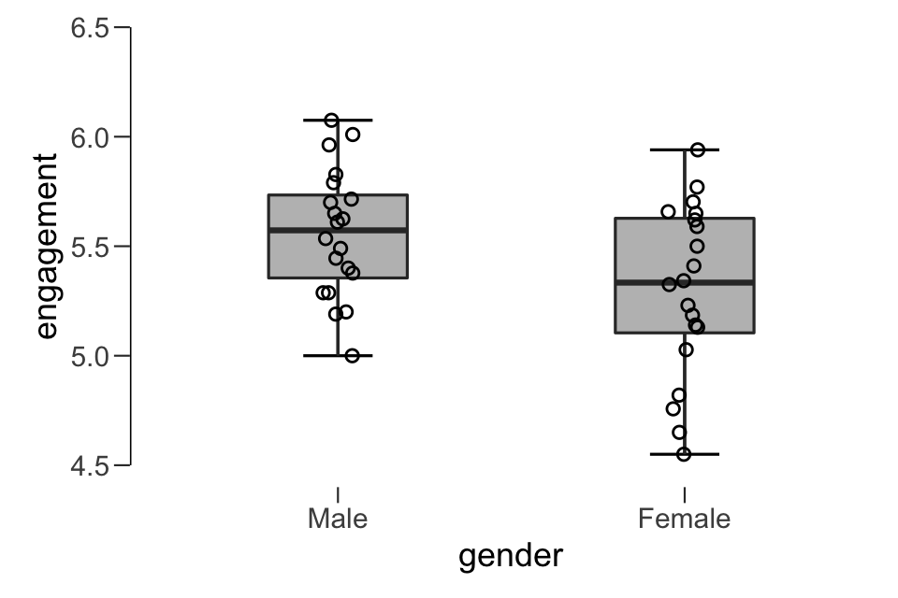
No Outliers
Outliers are visible on boxplots when data points are located more than 1.5 box-lengths from the “whiskers” of the box

Slide 18
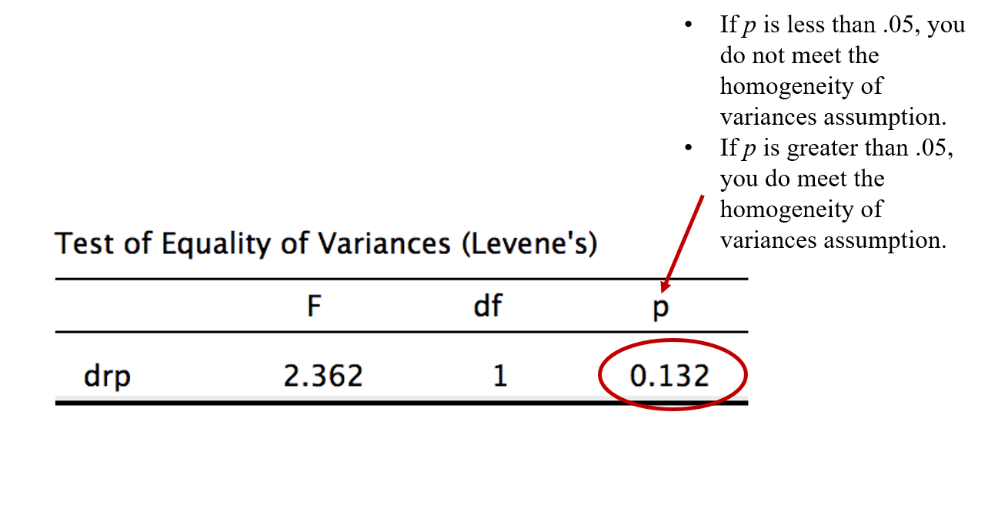
Homogeneity of variance
Need to check that the variance of your two groups are equal
  Levene’s Test

Slide 19
Effect Size: Cohen’s d
Effect Size | Strength
.2 | Small
.5 | Medium
.8 | Large

Slide 20
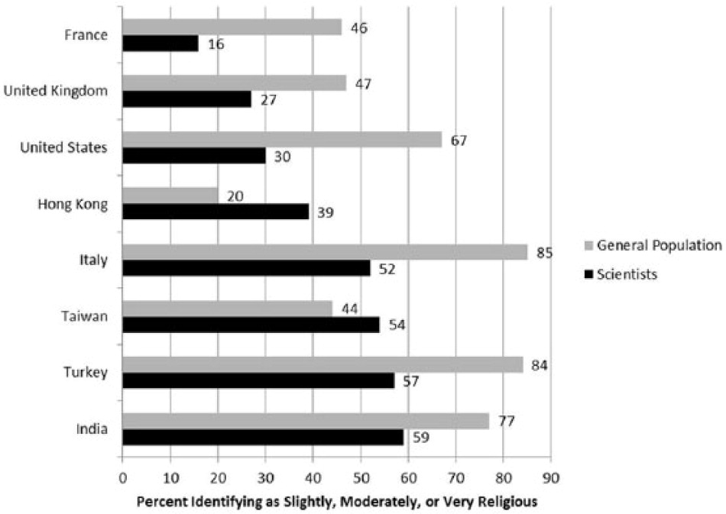
Walk-Through Example
Researchers Elizabeth Barnes, Jasmine Truong, and colleagues (2020) conducted a series of studies at Arizona State University to understand if there is bias against Christian students in the natural sciences. Pew Research Center (2019) surveys have found that approximately 65% of the population in the United States describe themselves as Christian; however, a worldwide sample of over 9,000 scientists in biology and physics found lower levels of religiosity in scientists compared to the general population in the United States (see graph below; Howard Ecklund et al., 2016). Further, 22% of scientists in the United States said that science has made them “much less religious” (p. 5).

Slide 21
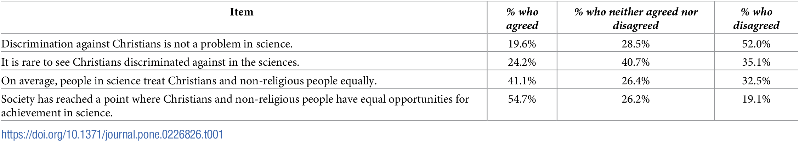
Barnes et al. (2020)
This led Barnes and colleagues (2020) to their research questions: Why are Christians underrepresented in the natural sciences? Do negative stereotypes about the scientific abilities of Christian students put them at a disadvantage in the natural sciences? Their first study found that it was common for biology students to report perceptions of bias against Christians in science (see table below).

Slide 22
Barnes et al. (2020)
Once they gathered data to show that students perceive there is a bias against Christians in science, they wanted to conduct studies to help determine if academic scientists in the natural sciences exhibited biased behavior towards Christian students. To do this, they conducted two experimental studies. We will analyze Study 2 data when we discuss One-Way ANOVAs, for now we will look closer at Study 3. For Study 3, the researchers recruited 261 faculty in biology and randomly assigned them to one of two conditions:
Faculty in condition one read a graduate student application that signaled evangelism. Their application listed the student taking a mission trip for Campus Crusade for Christ, with a recommendation letter from a mentor in that ministry.
Faculty in condition two read a graduate student application that listed the student taking a service trip for the United Nations Children’s Fund, with a recommendation letter for a mentor in that organization.
All other aspects of their application were kept consistent (e.g., same GPA and GRE scores). Faculty were asked to rate the student on competence, hireability, and likeability using a 7-point likert scale from 1 (not at all) to 7 (very much). Higher scores on each of these scales indicate higher levels of competence, hireability, and likeability.

Slide 23
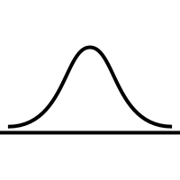

Barnes et al. (2020) Research Question 1
Are there significant differences in biology faculty mean ratings of graduate student competence between the Christian student condition and the Control student condition?
Christian Graduate
Student Condition
Control Graduate
Student Condition

Slide 24

What do you think we will find when we analyze the data?
What are your hypotheses?

Slide 25
Hypotheses:
DV Competence
The null hypothesis is:
  Conceptual H₀: There are no differences in faculty ratings of graduate student competence between the Christian student condition and the Control student condition.
  Mathematical H₀: The mean score for graduate student competence in the Christian student condition is equal to the mean score for student competence in the Control student condition; M₁ = M₂
The alternative hypothesis is:
  Conceptual H₁: There are significant differences in faculty ratings of graduate student competence between the Christian student condition and the Control student condition.
  Mathematical H₁: The mean score for graduate student competence in the Christian student condition is not equal to the mean score for student competence in the Control student condition; M₁ ≠ M₂

Slide 26
Barnes et al. (2020) Research Question 2
Are there significant differences in biology faculty mean ratings of graduate student likeability between the Christian student condition and the Control student condition?
Christian Graduate
Student Condition
Control Graduate
Student Condition

Slide 27
What do you think we will find when we analyze the data?
What are your hypotheses?

Slide 28
Hypotheses:
DV Likeability
The null hypothesis is:
  Conceptual H₀: There are no differences in faculty ratings of graduate student likeability between the Christian student condition and the Control student condition.
  Mathematical H₀: The mean score for graduate student likeability in the Christian student condition is equal to the mean score for student likeability in the Control student condition; M₁ = M₂
The alternative hypothesis is:
  Conceptual H₁: There are significant differences in faculty ratings of graduate student likeability between the Christian student condition and the Control student condition.
  Mathematical H₁: The mean score for graduate student likeability in the Christian student condition is not equal to the mean score for student likeability in the Control student condition; M₁ ≠ M₂

Slide 29

Let’s Analyze the Data!
Notes:
This Photo by Unknown Author is licensed under CC BY-ND

Slide 30

Creative Commons License
Notes:
CC BY-NC-ND: This license allows reusers to copy and distribute the material in any medium or format in unadapted form only, for noncommercial purposes only, and only so long as attribution is given to the creator.

